Slide 1


Senior living trends
June 5, 2024
PRESENTED BY
Mimi Rossi Senior Vice President Head of Senior Living Research Ziegler
B.C. Ziegler and Company | Member SIPC & FINRA
For Institutional Use Only

Slide 2


Ziegler Investment Banking Platform
Ziegler is a privately held, national boutique investment bank, capital markets and proprietary investments firm. Specializing in the healthcare, senior living and education sectors, as well as general municipal and structured finance, enables us to generate a positive impact on the communities we serve.
Investment Banking
Strategic advisory, financing and capital planning solutions in healthcare, senior living and educational sectors as well as general municipal and structured finance
Investment Banking
Capital
Markets
Capital Markets
Active participant in municipal sales and trading including public, tax-exempt, taxable, private placement and preferred trading markets
Proprietary Investments
& Fund Management
Proprietary Investments & Fund Management
Providing opportunities for investors in senior living, healthcare services & technology solutions
Source: Ziegler Investment Banking

Slide 3




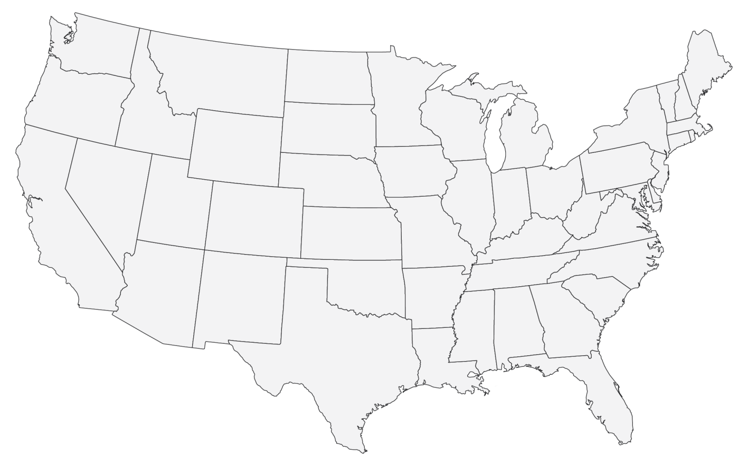




Ziegler’s National Footprint
HEADQUARTERED at One North Wacker Drive in Chicago with regional and branch offices throughout the U.S., Ziegler provides its clients with capital raising, strategic advisory services, fixed income sales & trading and research.
SEATTLE, WA
520 Pike Street
Suite 1505
Seattle, WA 98101
MINNEAPOLIS, MN
333 South 7th Street
Suite 2170
Minneapolis, MN 55402
MILWAUKEE, WI
790 N. Water Street Suite 2275
Milwaukee, WI 53202
CHICAGO, IL
Headquarters
One North Wacker Drive
Suite 2000
Chicago, IL 60606
1902
NEW YORK
2 Grand Central Tower
140 East 45th Street
Suite 2200
New York, NY 10017
established
180+
BETHESDA, MD
7500 Old Georgetown Rd
Suite 750
Bethesda, MD 20817
number of associates
22
Registered offices
RICHMOND, VA
5701 Patterson Avenue
Suite 200
Richmond, VA 23226
NASHVILLE, TN
150 3rd Avenue South
Suite 1150
Nashville, TN 37201
Source: Ziegler Investment Banking

Slide 4
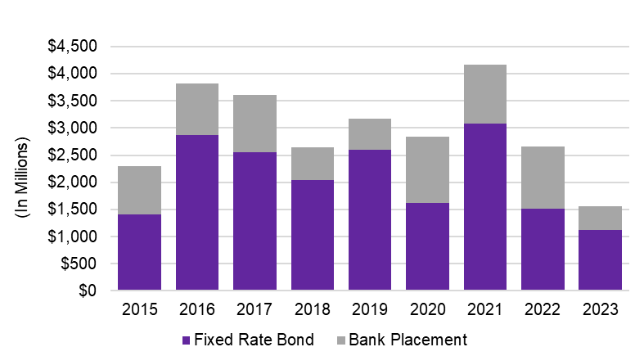
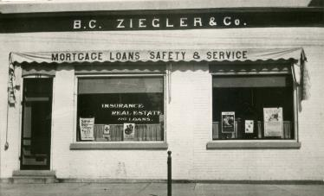
Ziegler – the market leader
Ziegler stands alone as an objective, independent industry leader for non-profit senior living investment banking
120 year old full service independent financial services firm, founding in 1902 with a focus on non-profit providers since 1928
National presence, demonstrated execution expertise and broad-based experience
Ziegler’s mission is to provide tailored financial solutions and our goal is to be our clients trusted advisor and partner
ZIEGLER SENIOR LIVING FINANCING VOLUME
1990 - 2023
Public Fixed Rate Bond Experience ⁽¹⁾
Senior Living Direct Bank Placement Experience ⁽²⁾
40
33
46
22
23
42
35
Ziegler Office Circa 1913
Based on full credit given to senior manager of lead-managed underwriting principal volume for senior living transactions completed nationally. Rankings and amounts through Refinitiv data as of 12/31/23
Ziegler Investment Banking as of 12/31/23

Slide 5
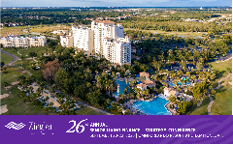
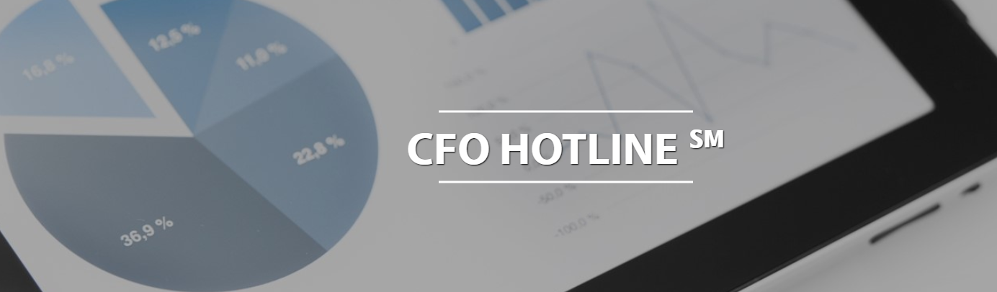





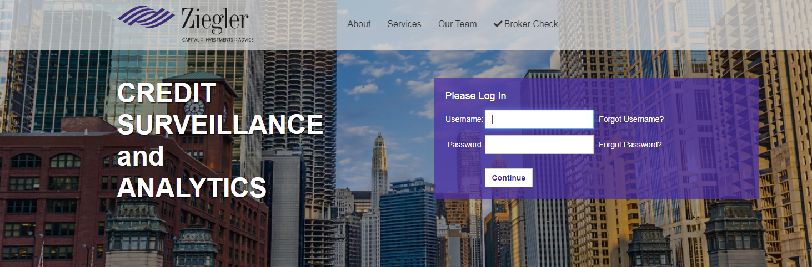
Ziegler’s Senior Living Research, Education & Thought Leadership
Numerous educational events annually
External industry research
Internal research & database management
Industry communication
Ziegler Credit Surveillance and Analytics
Source: Ziegler Investment Banking

Slide 6


Macro Sector Observations
OPPORTUNITIES
  Demographic growth
  Demand for diversified services
    Residential
    HCBS
  Technology and innovation
  Not-For-Profit success in partnership
HEADWINDS
  Workforce challenges
  Expense pressures
  Construction-cost inflation
  For-Profit competition impacting demand
  Uncertainty with skilled nursing
  Occupancy and Financial pressures (for some)
Source: Ziegler Investment Banking

Slide 7
Demographics: Significant decade ahead
Increase in 75+ Population by Decade
2014-2024: 6.9M | 2024-2034: 11.7M | 2034-2044: 7.9M
Youngest Boomers turn 75
Source: U.S. Census Bureau, Population Projections Released July 2022

Slide 8


Long-Term Senior Demographic Trends
By Generation - USA
60,000,000
7.00%
50,000,000
6.00%
5.00%
40,000,000
Population
4.00%
Growth Rate
30,000,000
3.00%
20,000,000
2.00%
10,000,000
Baby Boomers Generation X
1.00%
-
0.00%
2016 2020
Source: US Census Bureau
2024
2028
2032 2036
Population Age 75+
2040 2044
75+ Growth Rate
2048
2052
2056
2060

Slide 9
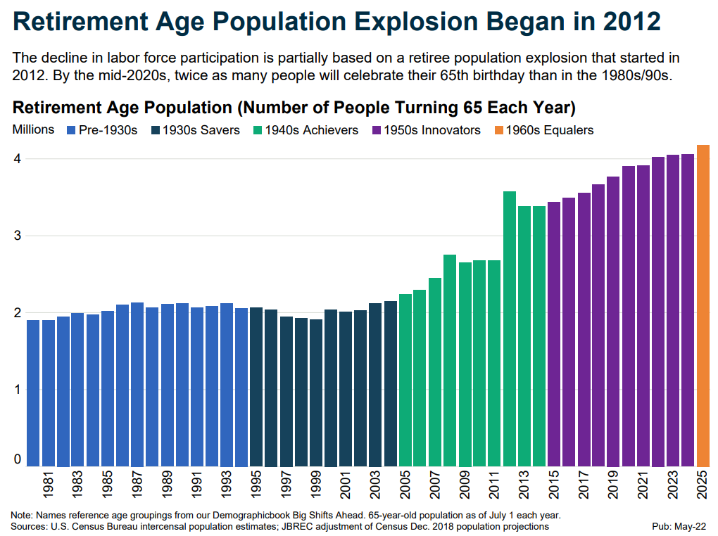

Aging By Generation

Slide 10
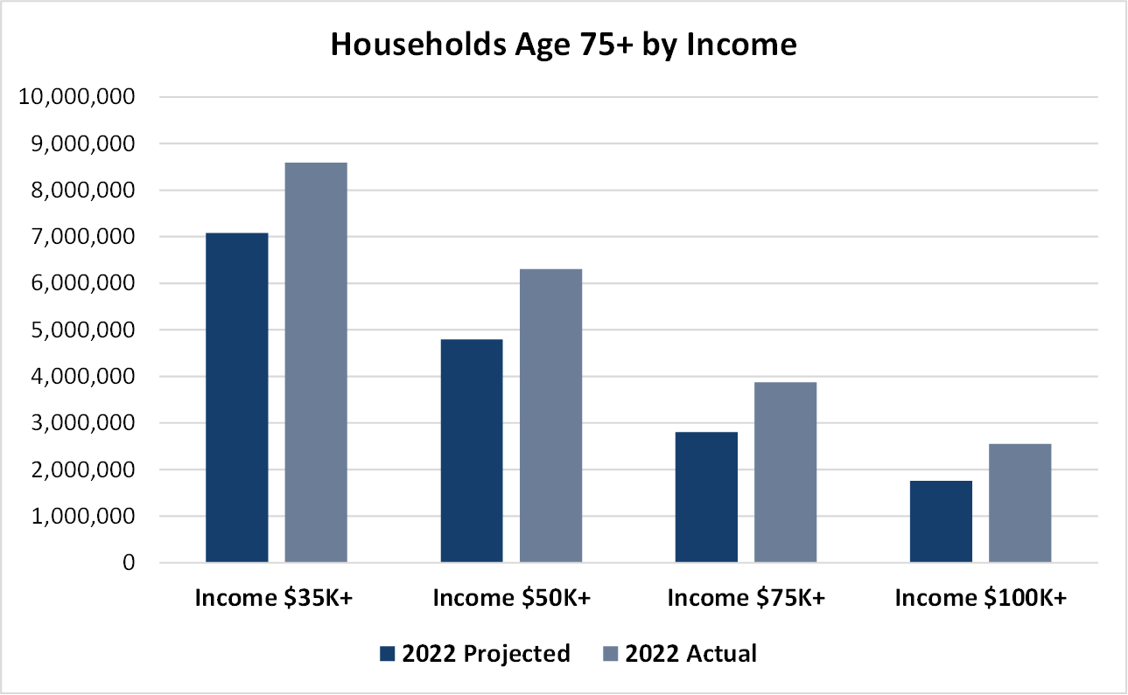
Will Seniors Have Enough Resources?
Source: Environics Analytics

Slide 11
Are Seniors Resources Stalled?
Annual Growth
16.0%
14.0%
14.3%
12.0%
12.2%
10.0%
9.9%
8.0%
6.0%
7.4%
5.2%
6.2%
4.0%
4.1%
2.0%
3.4%
0.0%
HHs with Income $35K+
HHs with Income $50K+
2022 Projected
HHs with Income $75K+
2022 Actual
HHs with Income $100K+
Source: Environics Analytics

Slide 12
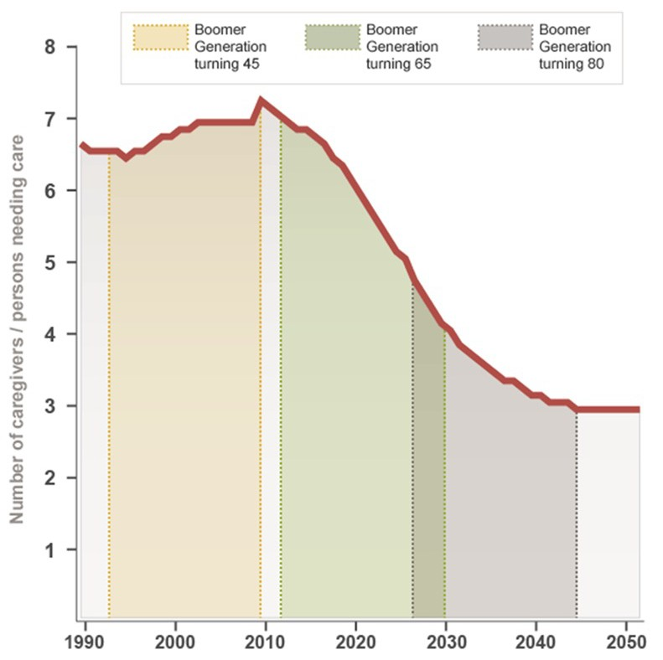
Who Will Provide Support for Future Seniors?
As a larger percentage of the population ages, fewer people to care for seniors
Caregiver support ratio
‒ 6:1 today
‒ 4:1 by 2030
‒ 3:1 by 2050
Two sides to the story:
‒ Increased demand and need for senior housing and services
‒ Labor challenges
Source: United States Census Bureau

Slide 13
Growth Defined
Affordable
Market Rate
Middle Market
New Community Development
Satellite Campuses
Unit Expansions
GROWTH Highlights
Some new community growth but with low/no skilled nursing
Significant investments in existing campus
Affiliations, Acquisitions, Mergers activity is high
Home and community-based service expansion
Affiliations, Acquisitions, Mergers
Home & Community-Based Services
Services (Third-Party Mgmt.; IT Solutions)
Source: Ziegler Investment Banking

Slide 14

System Trends 2023
LZ 200 Publication: Background and Methodology
Size not quality
Not-for-profit multi-site senior
living organizations primary focus
Descriptive information on each
system
  state, size (by type of unit),
  classification of system, rating,
  accreditation, addition of 2nd
  community.
Statistics related to affiliation, employees, residents and more
Excludes affordable units and managed units when computing size; excludes primarily acute/post-acute/health care systems
Comparable to other listings of largest organizations (i.e., Fortune 500)
Source: 2023 LeadingAge Ziegler 200 Publication (data as of 12/31/22)

Slide 15
2023 LeadingAge Ziegler 200
The Nation's Largest Not-for-profit Multi-site Senior Living Organizations
RANKED BY TOTAL SENIOR LIVING UNITS
Source: 2023 LeadingAge Ziegler 200 Publication (data as of 12/31/22)

Slide 16
2023 LeadingAge Ziegler 200
The Nation’s Largest NFP Multi-Site & single-site Senior Living Organizations - Ranked by Total Senior Living Units
Among Largest 200 Multi-sites
Among Largest 200 Single-sites
Source: 2023 LeadingAge Ziegler 200 Publication (data as of 12/31/22)
Notes:
Will open their new location and become a multi-site

Slide 17

Expansions, affiliations
Recession
Evolution of NFP Systems
Source: 2023 LZ 200 Largest 25 Providers (as of 12/31/22)

Slide 18
NFP Senior Living Community Growth: LZ 200 Trends
2022 Data
Expansions: 21
Affiliations, Acquisitions: 30
New Communities: 7
Dispositions & Closures: -41
Sources: 2020-2023 LeadingAge Ziegler 200 Publications (data YE 12/31); Note: Expansions only include those projects adding 25 or more units

Slide 19
Drivers for NFP senior living consolidation
Financial Pressure
Occupancy Challenges
Operational Cost Increases
  Labor
  Food
  Insurance
2023
2000
2010
Ability to Attract & Retain Talent
Complexities of SN & Healthcare
Financial Pressure
Leadership Turnover
Financial Pressures
Bondholder/Lender Pressures
Complexities of SN & Healthcare
Access to Capital
Influence
Health System Consolidation
Leadership Turnover
Competition
Leadership Turnover
Technology Demands
Growth Capital
Technology Demands
Health System Consolidation
Reinvestment Requirements
Access to Capital
Competition
Board Strength
Competition
Access to Capital
Technology Demands
Ability to Attract Talent
Diversify Service Lines
Health System Consolidation
Complexities of Healthcare
Ability to Attract Talent
Diversify Service Lines
Source: Ziegler Investment Banking (compiled data from multiple publications/sources), data as of 12/31/23

Slide 20
NFP Sector consolidation: Cumulative
(2010-2023)
Similar to other health and service-related sectors, the not-for-profit senior living sector is consolidating
Sponsorship Transitions
  Affiliations, Mergers, Acquisitions
  Dispositions
Note: Includes market-rate communities; excludes government subsidized; The ELGSS community count (160+) and the Dwyer Workforce counts (50) are excluded; Source: Ziegler Investment Banking (compiled data from multiple publications/sources), data as of 12/31/2023

Slide 21
LZ 200 System Growth:
Affiliations, Acquisition
Activity
Provider Systems with 3 or more Affiliations
Growth through affiliation, merger or acquisition
Source: 2023 LeadingAge Ziegler 200 Publications (data as of 12/31/22)

Slide 22



































Recent NFP examples (2022 & 2023)
Source: Ziegler Investment Banking 12/31/2023

Slide 23

























Recent M&A Transactions
Repeat clients range from large, publicly-traded companies to mid-size not-for-profits.
April 2024
April 2024
March 2024
March 2024
February 2024
February 2024
Not-for-Profit Health System
Sold a 122-bed Skilled Nursing Facility in Orangeburg, SC to
Sold a 1,000 unit/bed, 3-Community CCRC Portfolio in Pennsylvania to
Revolving Line of Credit for a Skilled Nursing and Rehabilitation Center in Illinois
Sold a 3,250-Bed/Unit IL/AL/MC/SNF, 16-Community Portfolio across 6 States to
Sold a 100-bed Skilled Nursing Community in Chicago, IL
Sold a 177-Unit IL/AL Community in Portland, OR
$11,500,000
$183,000,000
SELL-SIDE ADVISOR
SELL-SIDE ADVISOR
SELL-SIDE ADVISOR
FINANCIAL ADVISOR
SELL-SIDE ADVISOR
SELL-SIDE ADVISOR
December 2023
November 2023
October 2023
July 2023
May 2023
December 2023
June 2023
Sold a 316-Unit LPC
in Birmingham, AL to
Sold a 135-Bed
Skilled Nursing Facility
in Chicago, IL to
Sold a 101-Unit IL/AL/MC Community in Mequon, WI to
Sold a 41-unit Assisted Living and Memory Care Centre in Fort Wayne, IN
Sold a 3-Community SNF Portfolio in CA
Sold a 41-unit Assisted Living and Memory Care Centre in Fort Wayne, IN
Sold a 246-Bed/Unit AL/SNF Community in
Garfield Heights, OH
$11,200,000
$35,640,000
$23,500,000
$11,200,000
SELL-SIDE ADVISOR
SELL-SIDE ADVISOR
SELL-SIDE ADVISOR
SELL-SIDE ADVISOR
SELL-SIDE ADVISOR
SELL-SIDE ADVISOR
SELL-SIDE ADVISOR
May 2023
May 2023
May 2023
May 2023
December 2022
December 2022
Regional
Owner/Operator
Freddie Mac Refinancing of a 364-Unit IL/AL/MC
Community in Lakewood, CO
Sold a 2-Community
MC Portfolio in Illinois to
Sold a 306-Unit CCRC in
McMinnville, OR to
Sold a 192-Unit CCRC in Mount Morris, IL to
Sold a 348-Unit IL/AL
Community in Elmhurst, IL
Sold a 2-Community CCRC Portfolio in CA
$15,700,000
$105,600,000
$19,000,000
$42,000,000
$34,000,000
SELL-SIDE ADVISOR
FREDDIE MAC FINANCING
SELL-SIDE ADVISOR
SELL-SIDE ADVISOR
SELL-SIDE ADVISOR
SELL-SIDE ADVISOR
* Fannie Mae refinancing facilitated by M&T Realty Capital Corporation, a fully accredited Fannie Mae DUS® lender. M&T Realty Capital Corporation is a wholly-owned subsidiary of M&T Bank. Equal Housing Lender. Member FDIC. “DUS®” is a registered trademark of Fannie Mae.
23
23

Slide 24
Life Plan Community/CCRC Sector consolidation
NFP Only: 62% multis, 38% singles YE 2015: 59% multis, 41% singles
Source: Ziegler Investment Banking National CCRC Database, 12/31/23
Notes:
Dan comments- Will always have strong single-sites; following trend unfolding over past two decades in hospital/health system sector

Slide 25
Future New NFP Locations
40
To Open in the Next Five Years
10
30
# LPCs To Open in Next Five Years
Traditional Definition (IL thru SN)
# Non-LPCs To Open in Next Five Years
IL Only, IL/AL, Other
Source: Ziegler Investment Banking, 9/1/23

Slide 26
For-Profit Investment in Independent living is Increasing
* Excludes CCRCs
Source: NIC MAP® Data Service (3/31/24)

Slide 27
Overall Seniors Housing Inventory
INFLATIONARY PRESSURES
PANDEMIC ONSET
GREAT RECESSION
Total Not-for-Profit inventory in decline if include freestanding nursing home counts
Sources: Ziegler Investment Banking estimates and projections, and periodic information from Ziegler, ASHA 50, Argentum 150, CMS, LeadingAge 200, and NIC MAP31 through Sept. 2023
Notes:
Dan- note regarding significant number of ‘new’ owner and operator groups on FP side in past decade

Slide 28
Record Total Number of available & Occupied Seniors Housing Units
Record levels
Source: NIP MAP, Q4 2023

Slide 29
CCRC/Life plan community growth
Cumulative growth
Source: Ziegler LPC (CCRC) Listing; 8/15/23; Projections for 2023-2029
Note, a small proportion of communities are excluded as year of opening is unknown as well as pre-1950 openings
Notes:
Dan-Note that this only reflects openings; I did not remove from the counts any closures over the years or those that are no longer an LPC per our definition

Slide 30
CCRC Occupancy Declines, Not-For-Profit CCRCs Maintain Higher Occupancy
3.4%
Source: NIC MAP® Data Service (3/31/24)

Slide 31
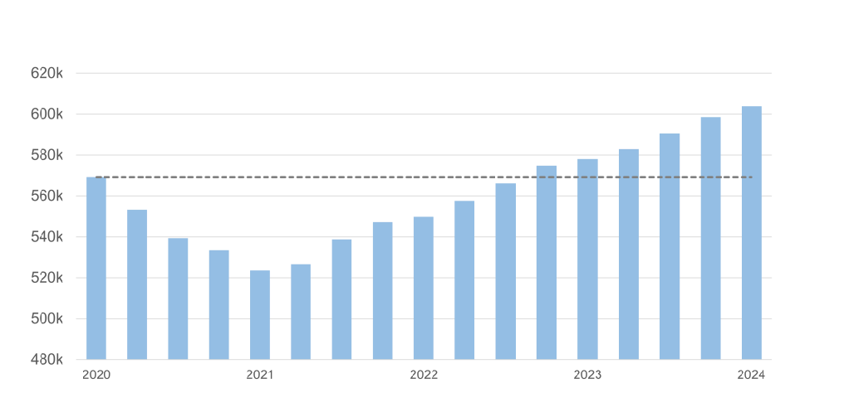


Record number of occupied units:
Exceeding pre-pandemic numbers
Occupied Units (Estimated) | Senior Housing | Primary Markets | 1Q06 – 1Q24
600k
500k
400k
300k
200k
100k
0k
2006
2008
2010
2012
2014
2016
2018
2020
2022
2024
Source: NIC MAP® Data Service (3/31/24)

Slide 32
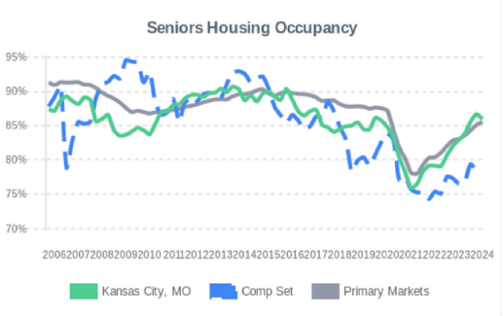
Occupancy trends (Missouri)
Source: NIC MAP Vision, Missouri Site Report (5/28/2024)

Slide 33
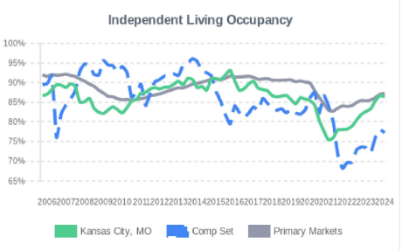
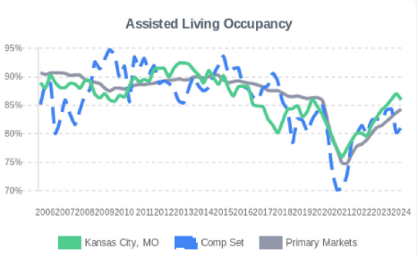
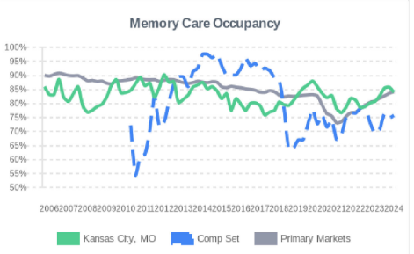
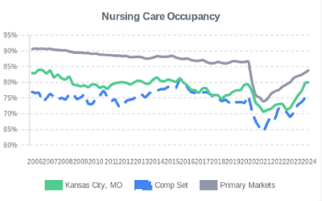
Occupancy trends (Missouri)
Source: NIC MAP Vision, Missouri Site Report (5/28/2024)

Slide 34
The Rationale for Diversification
Financial gain: Additional revenue
Risk management: Benefit to not having ‘all your eggs in one basket’
Ancillary business lines can often support primary service lines
Mission enhancement:
  Ability to expand services across a larger continuum
  Ability to serve consumers within different economic cohorts
Fosters new, creative partnerships
  Joint ventures are not uncommon in this space
THE WHY
Source: Ziegler Investment Banking

Slide 35
Service Line Diversification
More Traditional
Emerging
HOME CARE
PHARMACY
HOME HEALTH
BEHAVIORAL HEALTH
HOSPICE
REHAB
PACE
TECHNOLOGY-RELATED
CONTINUING CARE AT HOME
MANAGEMENT SERVICES
PRIMARY CARE
OTHER SERVICES (Consulting, Development Advising, etc.)
Source: Ziegler Investment Banking

Slide 36



















Provider Examples of service line Diversification
Source: Ziegler Investment Banking

Slide 37

Key “Smart Aging” Technology Subsectors
Ziegler Resources
New Workforce Technology Paper Coming Soon!
Source: Ziegler Investment Banking

Slide 38







$110M+
Committed Capital
30+
Portfolio Investments
150+
Senior Living Provider Investors
Experienced
Focused
Strategic
With over 60+ years combined experience, Ziegler and Link-Age launched the first fund in 2014
Investing in technology and service companies with innovative solutions focused on aging and post-acute service and care
Fostering collaboration and innovation between strategic investors and entrepreneurs to advance awareness and adoption of new innovations
Ziegler Link•Age funds
Venture capital funds seeking to generate both financial and strategic returns for investors across the healthcare and aging services landscape by uniting providers and entrepreneurs in advancing innovation and driving independence, and improved quality and cost of care for older adults.
Generating financial returns for investors
Fostering collaboration between strategic investors and portfolio companies
Positively impacting the lives of seniors and improving the healthcare experience
Source: Ziegler Investment Banking

Slide 39































The Ziegler Link•Age Funds are Invested in Prominent Companies in Aging and Post-Acute Care
*
*
*
*
*
*
* Portfolio company has been exited
Source: Ziegler Link.Age Funds, as of 12/31/2023

Slide 40
HISTORICAL INTEREST RATES (Senior Living)
Fed Fund Target Rate (2000 YTD-Weekly)
SOURCE: Bloomberg, as of 5/31/24

Slide 41
HISTORICAL INTEREST RATES
Weekly
30-Year “AAA” MMD
(2000 YTD - Weekly)
Source: Refinitiv Municipal Market Monitor as of 5/31/24

Slide 42
HISTORICAL INTEREST RATES (Senior Living)
30-Year “BBB” vs 30-Year “A” vs MMD 30-Year “AAA” (1990 YTD - Weekly)
SOURCE: Bloomberg and Refinitiv Municipal Market Monitor as of 5/31/24

Slide 43
Mark your calendars!

Slide 44
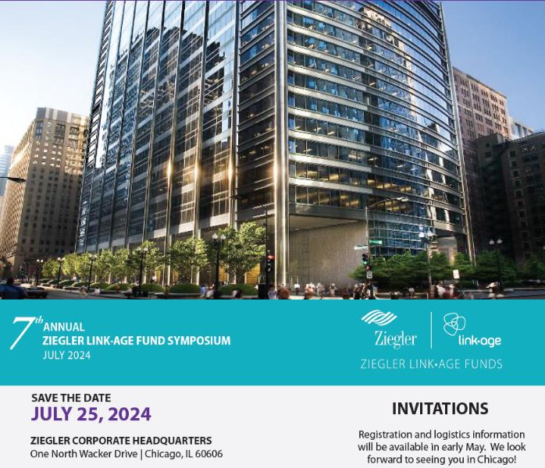

Slide 45


Slide 46

QUESTIONS?

Slide 47
ABOUT ZIEGLER
Ziegler is a privately-held investment bank, capital markets and proprietary investments firm
A registered broker dealer with SIPC & FINRA
Ziegler provides its clients with capital raising, strategic advisory services, equity & fixed-income trading and research
Founded in 1902, Ziegler specializes in the healthcare, senior living and educational sectors as well as general municipal finance
DISCLAIMERS
This presentation is designed to provide information regarding the subject matter covered and is intended for informational purposes only with the understanding that the material contained herein does not constitute legal, accounting, tax, or other professional advice. Although information which may be contained in this presentation has been obtained from sources which we believe to be reliable, we do not guarantee that it is accurate or complete and any such information may be subject to change at any time.
This presentation may contain forward-looking statements, which may or may not come to fruition depending on certain circumstances. In addition, please be advised that past financial results do not predict future financial performance. Portions of this presentation may be presented by non-Ziegler individuals whose opinions and information may differ from those of Ziegler, its employees or its representatives.

