Slide 1
Putting Data-Driven Strategies Into Action: Building, Executing & Measuring Successful Marketing Plans
June 5, 2024

Slide 2
Marybeth Roberts
Director of Sales, Marketing & Communications

Slide 3
John Knox Village is...
The 3rd largest not-for-profit single-campus
Life Plan Community
in the nation.

Slide 4
Our Health Services Include:
Assisted Living
Long-Term Care
Memory Care
Short-Term Rehabilitation
Outpatient Therapy
Home Health – MO/KS
Hospice - MO

Slide 5
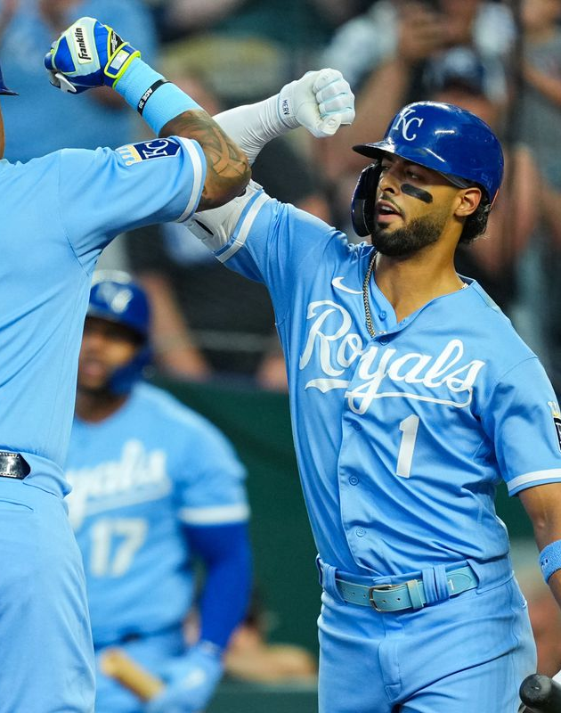
Let’s talk Baseball!
Baseball Stats:
ERA – Earned runs average
RBIs- Runs batted in
HR – Home runs
SO – Strike out
OBP – On Base Percentage
GIDP – Ground into a double play

Slide 6
Baseball Stats: Why are they important?
Create the team's game plan.

Slide 7
How do we get started?
Start by building your business plan:
Identify your key performance indicators – Your “Stats”
Learn about your marketplace
Understand your competition
Know your teams' strengths and weaknesses
Set measurable goals
Build the necessary plans and strategies to meet the goals in your “Game Plan”

Slide 8
How do we use the numbers ?
Decide who to talk to
Decide how to talk to them
Determine your budget & resources
Assess regularly
What is the message

Slide 9
Build Your Game Plan
Independent Living
Health Services
Leads
Engagement tracking
Deposits
Move-ins
Occupancy: Move-ins vs. Move-outs
Revenue
Referrals
Engagement tracking
Payor mix
Admissions
Census: Admissions vs. discharges
Revenue

Slide 10
The plan starts with generating leads
The Sales Funnel
Target Market 30,000
Response 1,800
Qualified Leads 800
Deposits 170
Move-Ins 150

Slide 11
Which tools are generating leads?
Digital
Email Blasts
Digital Ads
Resident Referrals
Direct Mail
Events
Seminars
Awareness
Television
A Place for Mom
3rd Party Vendors
Word of Mouth
Paid Social
Surveys
Educational Info
Branding
Least Expensive
Website
Social Media

Slide 12
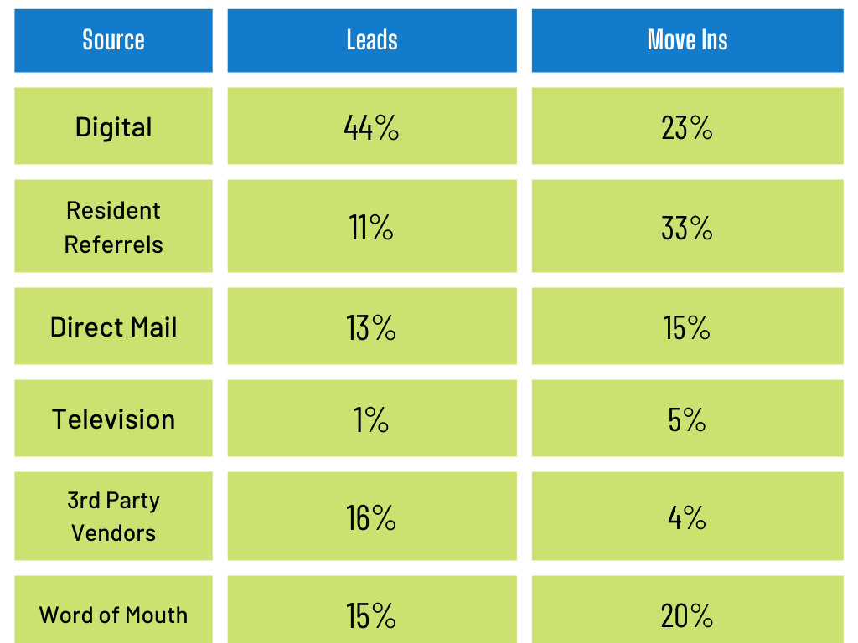
What tools are performing the best? Cost per lead? Resources? Results? ROI?

Slide 13
Shiny Penny Syndrome: What’s the best lead?
Is it the brand-new lead?
65% of our move-ins last year were from new leads generated in the 12 months prior to move-in
Everyone likes the shiny new penny.
BUT... 35% came from leads generated 12 months ago, or more. Some even from 5 years ago.
Don’t forget your established connections!!!

Slide 14
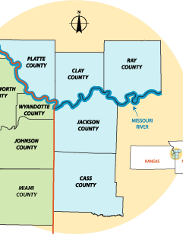
The Impenetrable “State Line Corridor”
5%

Slide 15
Is your message on point?
Is your message relevant to the audience?
Are you able to deliver on your service and promise?
Do you stand out from your competition?
Are you just “selling” your product – or are you solving the client's problem and providing a needed service?
Educate
Be a resource
Be responsive
Adapt

Slide 16
Know When to Pivot Tailoring your messaging based on data
EXAMPLE:
Knowing that 33% of last year's move-ins came from resident referrals
Utilize resident testimonials
Utilize residents for seminars, panel discussions and sales ambassadors at events, etc.
Use current residents in all marketing – print, television, digital

Slide 17
Real people - Real lives
xxxxx

Slide 18
Real people - Real lives

Slide 19
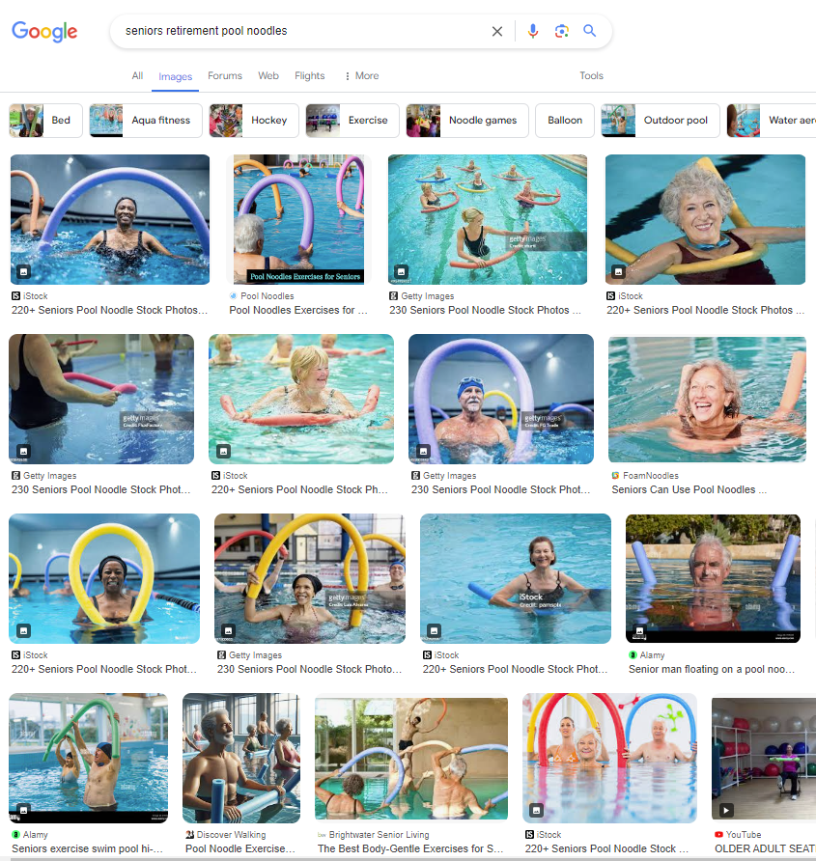
The ever-popular “Noodle” Ad!
Do you need to change your message?
What makes you stand out from the competition?

Slide 20
Adapting to the moment
Know your data. Was it a successful tool? This video has had 2,362 views since it went live in Oct. 2021.

Slide 21
A Successful “Game Plan”
Know your goals
Be sure your team is aligned to your goals
Work the plan
Gather data
Monitor your progress
Watch for trends, adapt as needed

Slide 22
Questions?
Comments?
Marybeth Roberts Director of Sales, Marketing & Communications
Email: mroberts@JKV.org
Phone: 816-251-8005

