Slide 1

Emerging Trends in Senior Living
Anthony Columbatto
May 9, 2023

Slide 2

Introduction
With the rapidly changing environment we find the world in now, we felt it beneficial for the team to present a “situational” or “environmental” analysis.
In this session, we will look at trends influencing the senior living industry and strategies to address these trends.

Slide 3
LABOR
Labor shortages are sweeping the nation post-COVID, impacting nearly all job categories.
For every 100 open jobs there are only 48* available workers in Missouri:
  In 2020, there were 113 workers available for every 100 jobs.
  In 2022, there are only 47 workers available for every 100 jobs.

Slide 4
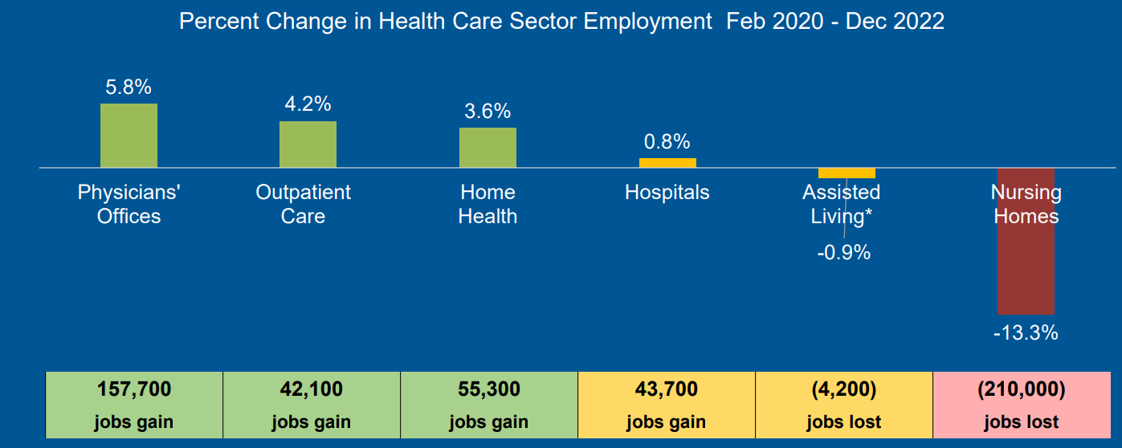
Industry Challenges - Workforce
Looking at data from the federal government, nursing homes are still facing historic job losses while other health care industries have mostly rebounded to pre-pandemic levels.

Slide 5
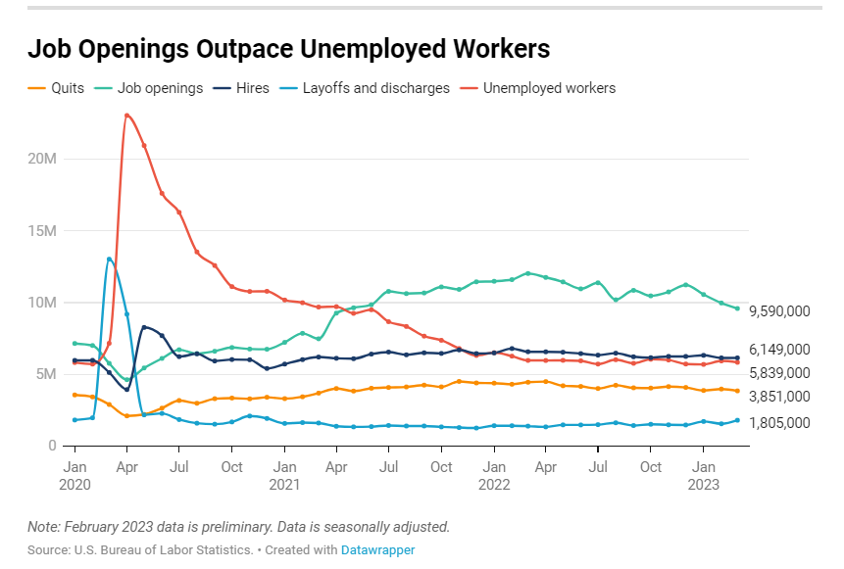



Job Openings Outpace Unemployed Workers
11.2M
4.1M
1.4M
Job openings still out numbered unemployed workers by 5.5M
Left their jobs
Job openings
Layoffs
July 2022

Slide 6
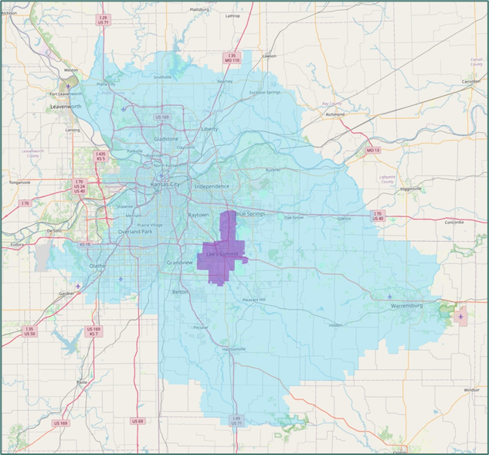
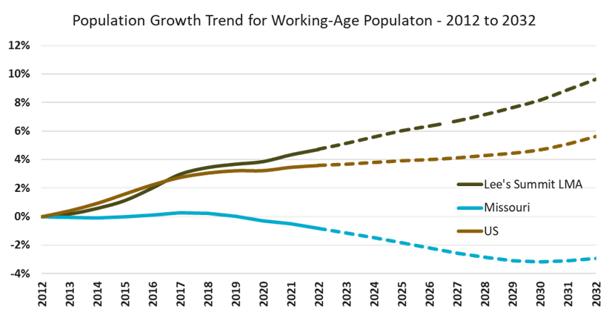
Lee’s Summit Labor Market Area
Lee’s Summit Labor Force March 2023
58,067
● Continued growth in Lee’s Summit area
● Population pool of people we are in a much more favorable position than other areas in MO
● Lee’s Summit market area is outpacing the U.S.
● In the Lee’s Summit market area, we are in a better place than most
77.5% of workforce commutes into Lee’s Summit
Source: 2022 Lee’s Summit Targeted Industry Analysis Report

Slide 7
How will Workforce Issues Impact Retirement Communities in the Future?
Increased cost to operate while at the same time the challenges for recruitment
Concern over a reduction in quality/service if qualified labor cannot be secured
Potential shift to technology to help offset increased labor costs and challenges to accessing labor
Very strong competitive environment for labor, particularly skilled
Cost of turnover
Mandated “living wage” changes will impact financial performance
“Labor already consumes 55-60% of operating budget. Pressure on this segment of spending forces us to cut in other areas or price ourselves out of the market.”
Participant comments from CLA 2021 Senior Living Trends Support

Slide 8
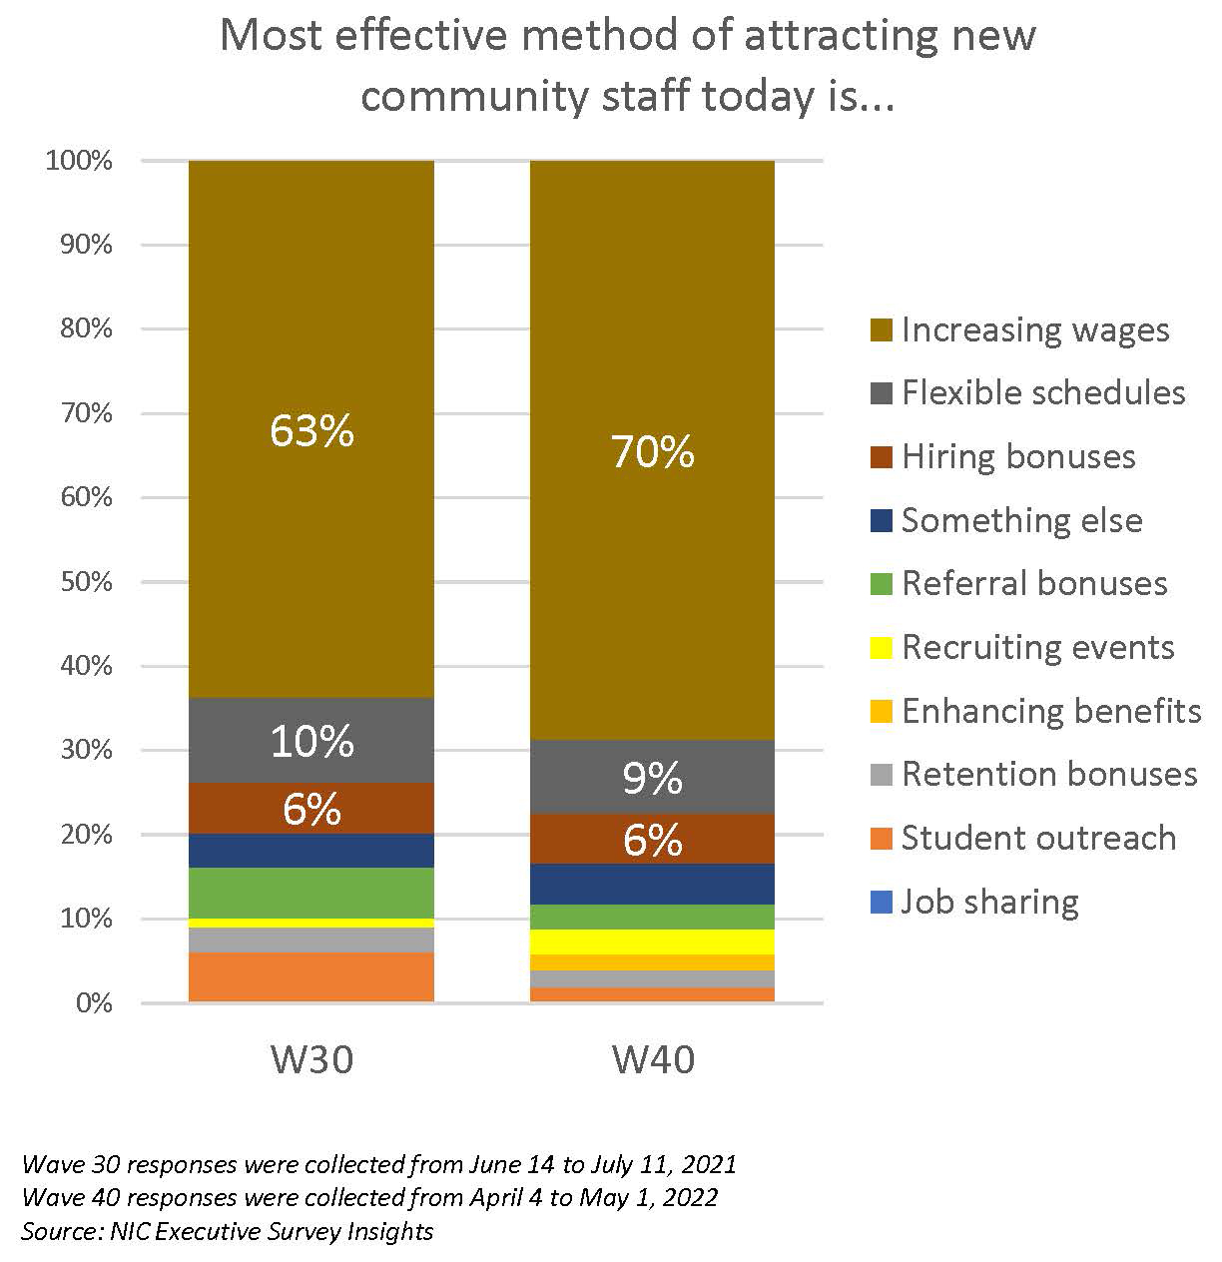
Methods to Attract New Staff
In the Wave 40 survey, three-quarters of respondents indicated the severity of their staffing shortages across their organizations was moderate (73%).
Attracting community and caregiving staff continues to be among operators’ most significant changes, followed by rising operating expenses (89% & 80%, respectively).

Slide 9
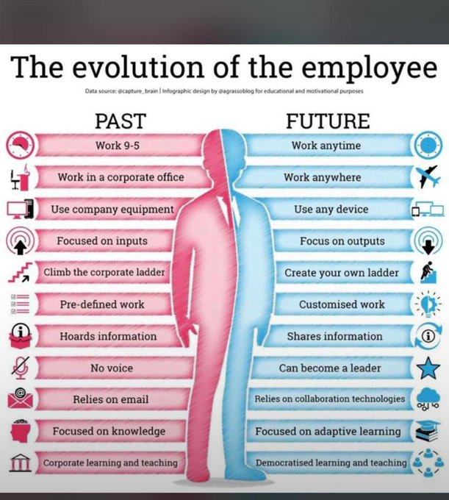
The Evolution of the Employee

Slide 10

DEMOGRAPHICS
The first wave of baby boomers is now in their mid-70s. Seniors with significant assets and income will dramatically increase for the next two to three decades.
Demographic growth will be coupled with shifts impacting customer expectations.

Slide 11
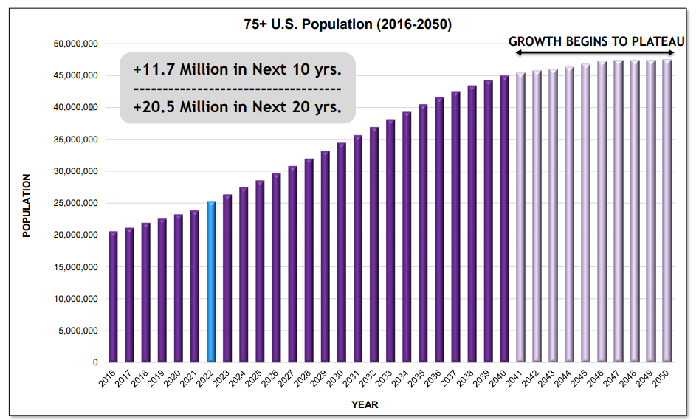
Demographics Driving Demand
Source: U.S Census Bureau, Updated 12/2021
Ziegler Presentation Sept. 2022

Slide 12
Jackson County Growth by Age

Slide 13
Households Age 75+ by Income
9,000,000
8,000,000
7,000,000
6,000,000
5,000,000
4,000,000
3,000,000
2,000,000
1,000,000
0
28%
32%
Income $35K+
Income $50K+
Income $75K+
Income $100K+
2021 Projected
2021 Actual

Slide 14
Kansas City Primary Market Area (PMA) Growth
The number of senior households age 75+ with incomes $50K+ increased 92% from 2014 to 2022, those households with incomes of $75K+ increased 156% over the same period.

Slide 15
The Changing Senior Consumer
Significant increase in second marriages
Significant increase in adults with no children
Significant increase in females with full careers
Increase in females with greater financial resources than spouse/partner
Much higher percentage of assets held in 401K plans
Significant increase in use of professional financial advisors

Slide 16

Senior Consumer Expectations
More dining venues
Design centers
Hospitality and service excellence initiatives
Wellness investment and messaging
Bigger and grander commons
Bigger and grander apartments
Entertainment options
Pickle ball, bocce, corn hole
Dog parks and car washes
Community dining, spa, salon
Community engagement
Affiliation with higher education
Affiliation with primary care and physician groups

Slide 17





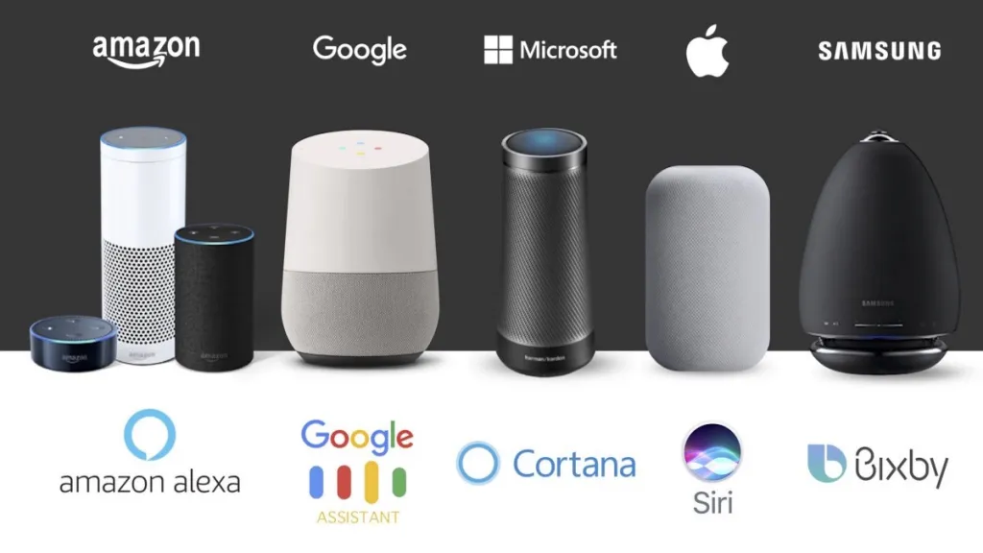


Staying at Home
Dining
Uber, Door Dash, and Amazon are transforming daily activities
Technology is easing caregiver demands (remote monitoring/care, telecare, medication reminders, alerts)
Virtual assistants (Alexa, Echo) allow customers without computer access the news, listen to music, control smart devices and could change the way that healthcare is accessed
Peace of Mind
Nursing
Engagement
Therapy

Slide 18
PAYMENT, REGULATORY AND LEGAL
Federal and state regulations will continue to make it difficult to operate profitably and remain in compliance while still offering a quality service that caters to the consumer.
Litigation will increase in the next several years with aggressive attorney marketing, a general lack of societal trust, and a growing acceptance of legal action.

Slide 19
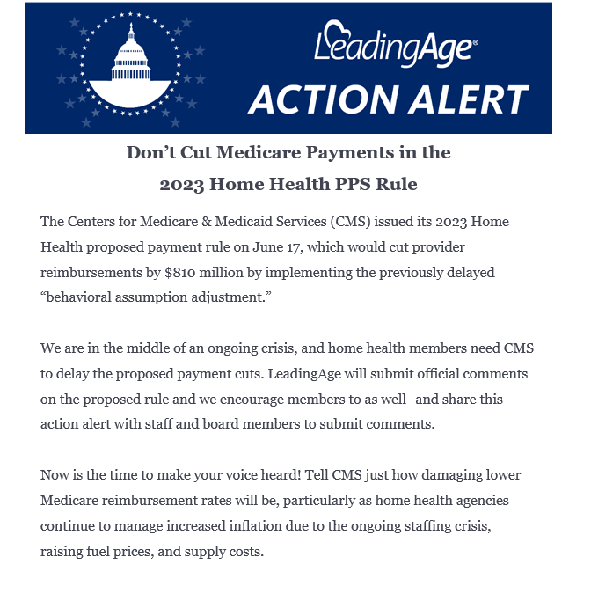
Payment Sources
Leadingage email 8.9.2022

Slide 20
Nursing in Life Plan Communities
44.5%
Percentage of respondents who indicate they have plans to downsize their nursing

Slide 21
Senior Living Options
Non-medical Home Care
Home-based and Community-based Services
Most plan to prioritize non-medical home care
Preparing for baby boomers while focusing on increasing demographics and service reach, providers showed diversity in their offerings with a focus on expanding reach and altering operations to provide home and community-based services.

Slide 22
Key Skilled Nursing Themes
Most not-for-profit skilled nursing settings are part of a continuum
Providers are taking a hard look at unit mix allocation (Independent living, assisted living, skilled nursing)
Conversion of semi-private to private skilled nursing units
Significant workforce pressures; driving occupancy
Most providers are not exiting skilled nursing, but are downsizing
Impacted greatest of all levels of living during pandemic

Slide 23

Medicaid Reform
In 2022, MO HealthNet modified Medicaid payments for SNFs to include:
  Rebasing from expense data based on 2019 cost reports (last rebase was completed in 1995)
  Case mix adjustments based on acuity
  Providers with high quality measures eligible for premium payments
  Significant increases expected this year, as well

Slide 24
PARTNERSHIPS
The industry has been stressed over the past three years creating a situation where many smaller organizations have affiliated with a larger entities.
  Mergers and acquisition have become a more prominent theme.
Providers must begin looking for partnerships to build on or enhance their community.
  Mutually beneficial partnerships with other organizations that can help improve financial performance, reduce risk, and increase service levels need to be explored.

Slide 25
Potential Partnership Opportunities
I-SNP - Institutional Special Needs Plans
Pharmacy
Ziegler Link-age Technology Fund
Group purchasing organizations
Paymerang – invoice payment automation solution

Slide 26
PARTNERSHIPS
Payactiv – earned wage access service
Medical director and physician engagement
Therapy services
Hospice and palliative care
Strategic home health partnerships
Where do residents have a gap in service that I cannot provide now or in the future?

Slide 27
TECHNOLOGY
Market has become very senior sensitive and is bringing many innovations providing enhanced care. Devices are becoming “smarter” every day.
Labor shortage has created even greater interest from technology industry to help solve this “person power” issue.
The use of technology has been accelerated over the pass two years due to the pandemic. Programs are being developed to grow the service levels offered through convenience related programs.
Link-Age Technology Fund has brought many new senior related programs to market. Most of the solution are targeting several pressure points: workforce solutions, family member platforms, telehealth, homecare, acute and post-acute convergence.

Slide 28
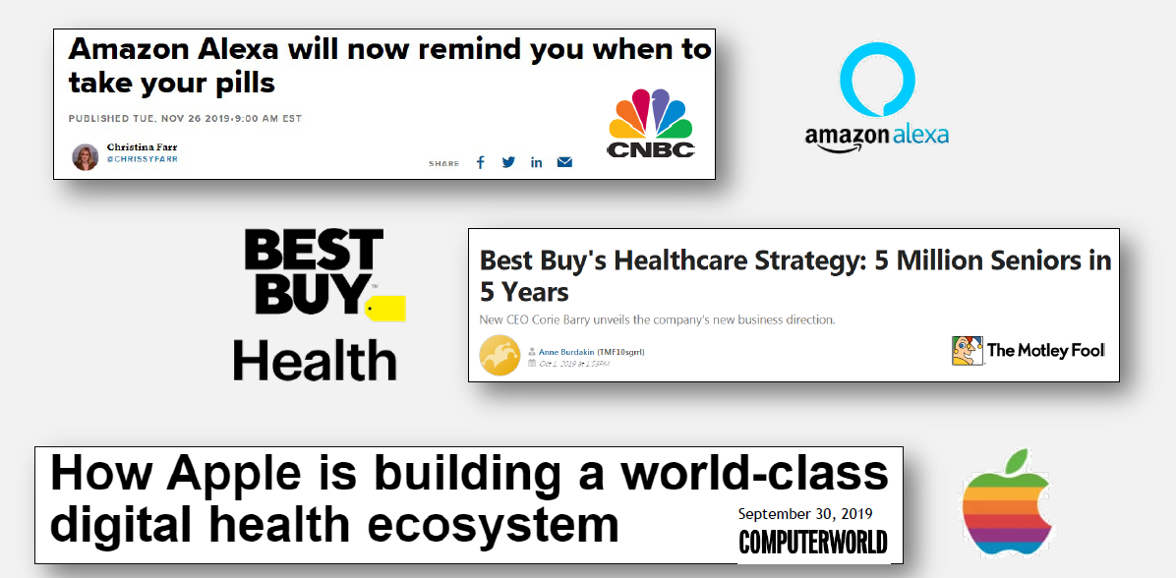
Senior Living Garnering Significant Attention in Technology

Slide 29
The Future of Senior Living Technology
Robotics
Machine Learning
Expanded Telecare
Home-enabled solutions
Remote Monitoring
Virtual Reality
Big Bets: New Kind of Competition

Slide 30
Health Services Technology
Have adopted electronic point of care/point of service documentation systems and electronic health/medical records.
Have adopted technologies, such as medication monitoring or telehealth remote monitoring.
Use social connectedness/resident engagement technology
Utilize more advanced analytical tools.
Implemented staff and resident screening technology due to the pandemic
Added infection control technologies.

Slide 31



Utilizing Technology as a
Solution & Strategic Advantage
Telehealth Solutions
Brain Fitness/
Cognitive Care Solutions
Resident Monitoring, safety, and fall solutions
Care Coordination Solutions
Smart Home Technology
Communication & Engagement Solutions
Workforce
Solutions
Noteworthy Trends
Technology adoption rose dramatically during the pandemic (residents, staff, family members)
Evolution of technologies from novel to norm (e.g., resident engagement, fall prevention)
Emergence of enterprise-level systems
Consolidation, particularly in Electronic Medical Record (EMR) space
  Three dominant EMR players in not-for-profit senior living care
Key “Smart Aging” Technology Subsectors

Slide 32

Thank you
Questions Comments

