Slide 1
Navigating the nursing home rating system

Slide 2
Data Sources
CMS's health inspection database - Includes the nursing home characteristics and health deficiencies issued during the 3 most recent standard inspections and any complaint investigations or infection control inspections in the past 3 years…These data may not be added in the same cycle as the standard inspection data. The following measures on Care Compare – Nursing homes including rehab services, and Provider Data Catalog come from this data source:
Health inspections data
Fire Safety inspections & emergency preparedness data
Penalties
Payroll-Based Journal (PBJ) system - The PBJ system allows nursing homes to electronically submit the number of hours facility staff are paid to work each day. The information is submitted quarterly, and is auditable to ensure accuracy. Staffing data are collected on the director of nursing, registered nurses (RNs) with administrative duties, RNs, licensed practical nurses (LPNs) with administrative duties, LPNs, certified nurse aides (CNAs), medication aides, and nurse aides in training…The following measures on Care Compare – Nursing homes including rehab services, and Provider Data Catalog come from this data source:
Total staffing (RN, LPN, CNA)
RN staffing
Physical Therapist hours
Staff Turnover

Slide 3
Data Sources
The Minimum Data Set (MDS) national database - Data for quality measures come from the MDS database… Information is collected about the resident's health, physical functioning, mental status, and general well-being. These data are used by the nursing home to assess each resident's needs and develop a plan of care. The following measures on Care Compare – Nursing homes including rehab services, and Provider Data Catalog come from this data source:
Quality measures
Staffing (resident characteristics used to estimate the amount of staffing needed)
Resident census (used in calculating staffing hours per resident day)
Medicare claims data - CMS uses bills that nursing homes and hospitals submit to Medicare for payment purposes to identify when hospitalizations and nursing home admissions take place. These are used to calculate hospital readmission rates, emergency room visits, and discharges.

Slide 4
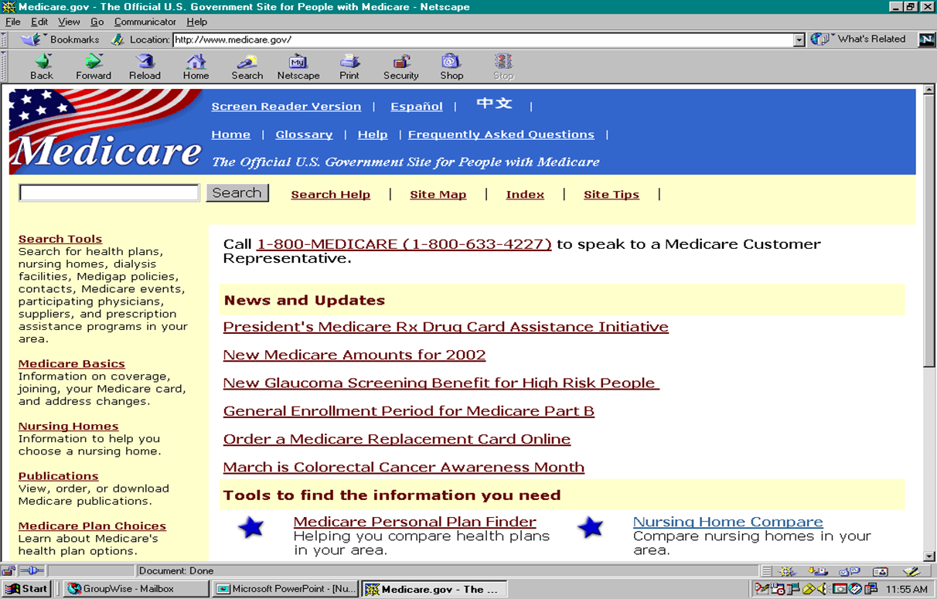
Background
Nursing Home Compare
December 18, 2008 - Five Star Quality Rating System was added to the Nursing Home Compare website
Onsite inspections
Quality Measures
Staffing Levels

Slide 5
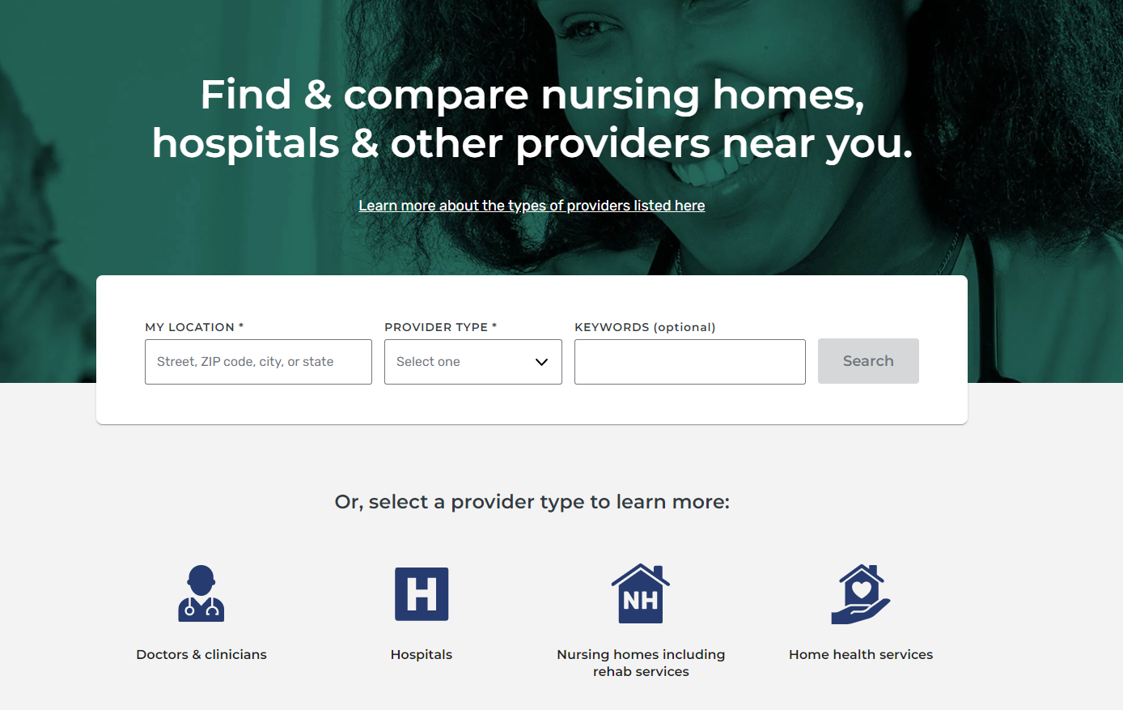
Care Compare
Effective December 1, 2020, Care Compare replaces eight health care-specific websites, such as Nursing Home Compare and Hospice Compare.

Slide 6
2022 Updates
January 2022 Revisions
Public Reporting of Turnover and Weekend Staffing Information on Medicare.gov Care Compare Website:
Effective with the January 2022 refresh, CMS began posting the following information for each nursing home on the Medicare.gov Care Compare website:
Weekend Staffing: The level of total nurse and registered nurse (RN) staffing on weekends (Saturdays and Sundays) provided by each nursing home over a quarter.
Staff Turnover: The percentage of nursing staff and number of administrators that stopped working at the nursing home over a 12-month period.

Slide 7
2022 Updates
April 2022 Revisions
Quality Measure Rating Threshold changes
Effective with the April 2022 refresh, CMS implemented the planned, regular increases to the Quality Measure (QM) rating thresholds, increasing each rating threshold by one-half of the average improvement in QM scores since the last time the thresholds were set. For the April 2022 refresh, the average improvement was determined from the period of April 2019 – January 2022.

Slide 8
2022 Updates
Changes to the Methodology for the Staffing Rating
The six measures are
CMS is revising the methodology for calculating the Staffing star rating. The new rating is based on six separate staffing measures. Similar to the Quality Measure (QM) rating, points are assigned based on the performance on each of these six measures. The points are then summed and the total staffing score is compared to staffing rating point thresholds to assign a rating of one to five stars. Case-mix adjusted total nurse (RN, LPN/LVN, aide) staffing levels (hours per resident per day).
Case-mix adjusted RN staffing levels (hours per resident per day)
Case-mix adjusted total nurse (RN, LPN/LVN, aide) staffing levels (hours per resident per day)on the weekend
Total nurse turnover, defined as the percentage of nursing staff that left the nursing home over a twelve-month period
Registered Nurse (RN) turnover, defined as the percentage of RN staff that left the nursing home over a twelve-month period
Administrator turnover, defined as the number of administrators who left the nursing home over a twelve-month period.
Notes:
CMS made two substantial changes in how Five-Star ratings are calculated in July 2022. First, they added three turnover measures and one weekend staffing measure to
the Staffing component. Second, they altered the calculation of the Overall rating to only allow five-star Staffing nursing homes to gain a star in their Overall rating. Previously,
four- and five-star Staffing homes could gain an Overall star. These two changes during the worst workforce shortage in the past 29 years for the nursing home industry resulted in substantial decreases in Staffing and Overall ratings. Nearly a third of nursing homes had a lower Staffing rating and a quarter had a lower Overall rating in July 2022 compared to June 2022.

Slide 9
2022 Updates
October 2022 Revision
Effective with the October 2022 refresh, CMS is implementing the planned, regular increases to the Quality Measure (QM) rating thresholds, increasing each rating threshold by one-half of the average improvement in QM scores since the last time the thresholds were set. For the October 2022 refresh, the average improvement was determined from the period of January 2022 – July 2022. The new rating thresholds are shown in Table 5 of this document. Note that the point thresholds for individual QMs did not change. CMS plans to implement these regular increases every six months.

Slide 10
five star Domains
Notes:
Why your stars matter:
Internal Factors
Quality improvement understanding the data that goes into the five star rating component of NHC can lead to better outcomes for your residents
• Census and profitability can use the five star rating as a marketing tool
• Recruitment & retention again use it as a tool to market to new staff and to retain staff
Consumer information
• Payors, hospital executives, • Hospital discharge planners
• Payment incentives and penalties
• Better loan rates
• Less risk from predatory legal practices

Slide 11
Three Domains
Health Inspections
Measures based on outcomes from state health inspections
Ratings for the health inspections domain are based on the number, scope, and severity of deficiencies identified during the three most recent annual inspection surveys, as well as substantiated findings from the most recent 36 months of complaint investigations and focused infection control surveys.
Staffing
Measures based on nursing home staffing levels and staff turnover
Ratings for the staffing domain are based on six measures. This includes three nurse staffing level measures (hours per resident per day) and three measures of staff turnover. Five of the six measures include RN hours.
Quality Measures
Measures based on MDS and claims-based quality measures (QMs)
Ratings for the quality measures are based on performance on 15 of the QMs that are currently posted on the Care Compare website. These include nine long-stay measures and six short-stay measures.

Slide 12
Make sure your data is accurate!
The rating system offers valuable and comprehensible information to consumers based on the
BEST DATA AVAILABLE

Slide 13
Health Inspection Domain

Slide 14
Health Inspection Domain
Scoring Rules
Health Inspection Results
Points are assigned to individual health deficiencies according to their scope and severity –more serious, widespread deficiencies receive more points, with additional points assigned for substandard quality of care.
Two types of health citations – F731 (Waiver of requirement to provide licensed nurses on a 24-hour basis) and F884 (COVID-19 reporting to the Centers for Disease Control) -- are not considered in the health inspection score calculation (nor are these reported on Nursing Home Care Compare).
Comparative Surveys are not reported on Care Compare or included in rating calculations, though the results of State Survey Agency determinations made during a Federal Oversight Survey are included.

Slide 15
Health Inspection Domain
Rating Methodology for Facilities with Abuse Citation(s) To make it easier for consumers to identify facilities with instances of non-compliance related to abuse, Care Compare includes an icon that identifies facilities that meet either of the following criteria:
1) Harm-level abuse citation in the most recent survey cycle: Facilities cited for abuse where residents were found to be harmed (Scope/Severity of G or higher) on the most recent standard survey or on a complaint or focused infection control survey within the past 12 months.
2) Repeat abuse citations: Facilities cited for abuse where residents were found to be potentially harmed (Scope/Severity of D or higher) on the most recent standard survey or on a complaint or focused infection control survey within the past 12 months and on the previous (i.e., second most recent) standard survey or on a complaint survey in the prior 12 months (i.e., from 13 to 24months ago).
Notes:
Nursing homes that receive the abuse icon have their health inspection rating capped at a maximum of two stars
That said-- due to the methodology used to calculate the overall rating, the best overall rating a facility that receives the abuse icon can have is four stars.

Slide 16
Health Inspection Domain
Survey Cycle Lookback | Weight
0-12 Month Lookback | 50.00%
13-24 Month Lookback | 33.3%
25-36 Month Lookback | 16.7%

Slide 17
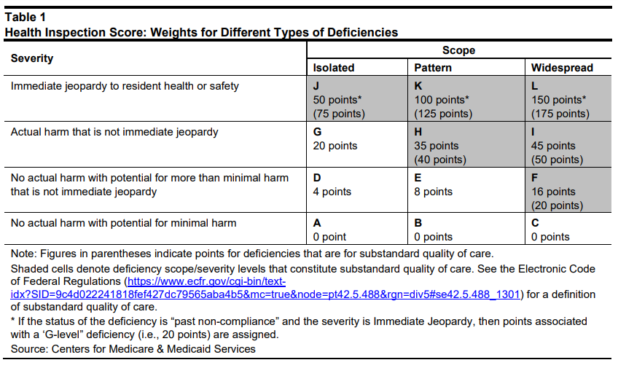
Health Inspection Domain
Notes:
Most of you are familiar with this scope and severity grid. This shows you the points that will be assigned for the different types of deficiencies related to scope and severity. This is how you will know how many points are assigned based on how many deficiencies you have had in each survey cycle. The points in parenthesis are the points assigned for substandard quality of care deficiencies. You each have a handout, Federal Regulatory Groups for Long-Term Care, those deficiencies in red are the deficiencies that will result in the higher point value. So if you are cited F742, Trtmt services for Mental/Psychosocial Concerns at a SS of “H” it will be assigned 40 points instead of 35 points. Also, don’t forget about substantiated and cited deficiencies received on complaint investigations during the survey cycle. Complaint surveys could result in points as well if a citation is received. Remember though that repeat deficiencies cited during a complaint survey within 15 days before or after a recertification survey will not count twice, however points will be assigned for the highest scope and severity. That means in you have a complaint survey that results in a citation for F742 cited at SS E and then 14 days later, during the recertification survey, you are cited for the same deficiency at an “H”, 40 points will be assigned instead of 8. Remember for the health inspection domain you want to have lower points.

Slide 18
Health Inspection Domain
Notes:
Repeat Revisits – Here you see the table for repeat revisits.
Number of repeat revisits required to confirm that correction of deficiencies have restored compliance.
Remember that points are assigned to individual health deficiencies according to their scope and severity –more serious, widespread deficiencies receive more points, with additional points assigned for substandard quality of care.
If a provider fails to correct deficiencies by the time of the first revisit, then these additional revisit points are assigned, up to 85 percent of the health inspection score for the fourth revisit. CMS calculates a total weighted health inspection score for each facility (including any repeat revisits). Note that a lower survey score corresponds to fewer deficiencies and revisits, and thus better performance on the health inspection domain. In calculating the total weighted score, more recent standard surveys are weighted more heavily than earlier surveys with the most recent period (rating cycle 1) being assigned a weighting factor of 1/2, the previous period (rating cycle 2) having a weighting factor of 1/3, and the second prior period (rating cycle 3) having a weighting factor of 1/6. The individual weighted scores for each cycle are then summed (after including complaint surveys, focused infection control surveys, and revisit points) to create the total weighted health inspection score for each facility.

Slide 19
Health Inspection Domain
CMS bases Five-Star quality ratings in the health inspection domain on the relative performance of facilities within a state. CMS determines facility ratings using these criteria:
The top 10 percent (with the lowest health inspection weighted scores) in each state receive a health inspection rating of five stars.
The middle 70 percent of facilities receive a rating of two, three, or four stars, with an equal number (approximately 23.33 percent) in each rating category.
The bottom 20 percent receive a one-star rating.

Slide 20
Health Inspection Domain
44% of homes in Missouri are a 1- or 2-star facility in the health inspection domain¹
38 have the abuse icon displayed on Care Compare
State | Number of Facilities | 1 star | 2 star |  | 3 star |  | 4 star |  | 5 star
 |  |  | Upper | Lower | Upper | Lower | Upper | Lower | Upper
Missouri | 508 | >113.333 | 113.333 | 57.667 | 57.667 | 36.00 | 36.00 | 18.667 | <18.667
¹Provider data as of 09/01/22
Notes:
44% 226 of 514

Slide 21
Health Inspection Domain
CMS bases Five-Star quality ratings in the health inspection domain on the relative performance of facilities within a state. This approach helps control for variation among states.
 |  | Health inspection Rating: | Number of Providers who can receive rating:
Top 10% | Lowest health inspection weight scores | 5 Stars | 50.7
Middle 70% | Middle inspection weight scores | 2 Star | 3 Star | 4 Star | 354.9
Bottom 20% | Highest inspection weighted scores | 1 Star | 101.4

Slide 22
Health Inspection Domain
When are scores changed and what changes them?
Rating thresholds are re-calibrated each month so that the distribution of star ratings within states remains relatively constant over time. However, the rating for a given facility is held constant until there is a change in the weighted health inspection score for that facility, regardless of changes in the statewide distribution.
Items that could change the health inspection score include the following:
A new health inspection
A complaint investigation or focused infection control survey that results in one or more deficiency citations
A second, third, or fourth revisit
Notes:
In addition to those items listed, Resolution of Informal Dispute Resolutions (IDR) or Independent Informal Dispute Resolutions (IIDR) resulting in changes to the scope and/or severity of deficiencies, The “aging” of complaint and/or focused infection control deficiencies can also change a health inspection score. Specifically, findings from complaint and infection control surveys are assigned to a time period based on the 12-month period in which the survey occurred; thus, when a citation from a complaint or infection control survey ages into a different cycle, it receives less weight in the scoring process, resulting in a lower health inspection score and potentially a change in health inspection rating.

Slide 23
Waiting on Survey???
Notes:
If you are waiting on survey, you are not alone. But while your waiting, you may not be able to improve your health inspection score except maybe with the aging of complaints. Those providers with a lot of health inspection points on the most recent survey remember have a 50% weighting factor. The only way to change that weighting factor of a recertification survey is with another recertification survey. So those points can’t “age” into cycle two or three which have lower weighting factors which would ultimately result in fewer points.

Slide 24
Health Inspection Domain
F0812 | Food Procurement, Store/Prepare/Serve Sanitary | 79 | 14.7% | 4.7%
F0880 | Infection Prevention & Control | 79 | 14.1% | 4.7%
F0689 | Free of Accident Hazards/Supervision/Devices | 74 | 13.0% | 4.4%
F0658 | Services Provided Meet Professional Standards | 50 | 8.9% | 3.0%
F0677 | ADL Care Provided for Dependent Residents | 49 | 8.7% | 2.9%
F0656 | Develop/Implement Comprehensive Care Plan | 43 | 8.3% | 2.6%
F0584 | Safe/Clean/Comfortable/Homelike Environment | 41 | 7.4% | 2.4%
F0888 | COVID-19 Vaccination of Facility Staff | 38 | 7.2% | 2.3%
F0625 | Notice of Bed Hold Policy Before/Upon Trnsfr | 35 | 6.8% | 2.1%
F0700 | Bedrails | 34 | 6.4% | 2.0%
Notes:
Analyze your health inspections and look for opportunities of improvement.

Slide 25
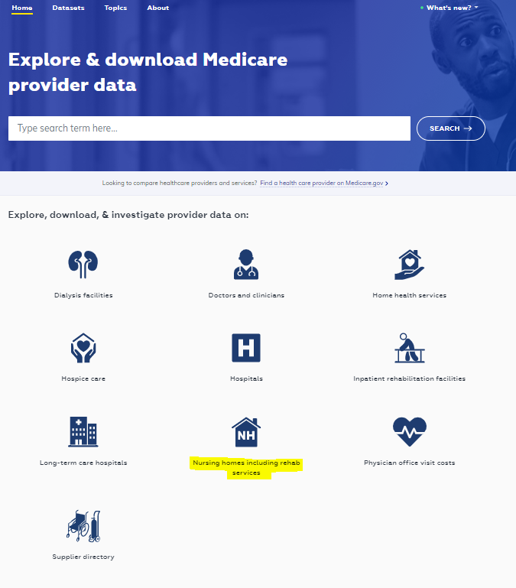
Health Inspection Domain
Where’s the data????
CMS Provider Data Catalog
Notes:
Using your data is key to managing the your five star score. Understand how you compare to others and setting benchmarks can help you improve your overall quality of care delivered which will translate to not only an improved health inspection rating but an improved overall rating.

Slide 26
Health Inspection Domain
Notes:
This is a very large file. Use the manage columns and filters available to drill it down to the information you need. The are many options to use. You may only want information for a specific county or an individual provider. This file can also be used to help you set those benchmarks as well for your QAPI. We have a lot of information, tools and resources available to us-it is imperative we know how and when to use them and they can assist you with overall improvement. Even the best of the best have a little room for improvement.

Slide 27
Health Inspection domain
Be PREPARED!
It’s an open book test! (CEP)
Use your data
FREE mock survey (QIPMO service)
Beef up your grievance program
QAPI
Know the top deficiencies in your state/region
Ask for a briefing at the end of the day (they may or may not indulge you);
ALL hands on deck
Pass on first re-visit
Tips to improve your health inspection score
Notes:
You have everything surveyors will have to prepare for your survey. Make a “Survey Binder” to prepared for survey. Being organized and prepared for a survey will assist in the process and allow it to be more manageable. Remember, the longer it takes for you to respond to surveyor requests for information, the longer they are in the house.
CASPER Reports
Request a QIPMO visit for a mock survey/processes of care audit
Rapid response to both actual events and near misses
Adopt a person centered approach to care and QAPI-Put your residents first!
Be involved, get your department leaders involved

Slide 28
Staffing Domain

Slide 29
Staffing Domain
The rating for staffing is based on six measures. The original two:
Case-mix adjusted total nursing hours per resident day (registered nurse (RN) + licensed practical nurse (LPN) + nurse aide hours) for a quarter averaged across all days (weekdays and weekends)
Case-mix adjusted RN hours per resident day for a quarter, averaged across all days (weekdays and weekends)

Slide 30
Staffing Domain
And the 4 new:
Case-mix adjusted total nursing hours per resident day (RN + LPN + nurse aide hours) for a quarter averaged across all weekend days (Saturdays and Sundays)
The percentage of nursing staff that left the nursing home over a twelve-month period.
The percentage of RNs that left the nursing home over a twelve-month period.
The number of administrators that left the nursing home over a twelve-month period.
Notes:
According to an AHCA report, Nationwide, 4,824 (32%) of nursing homes had a decrease in their Staffing rating. The Overall rating for 3,780 (25%) nursing homes decreased. A portion of the decrease in Overall ratings can be attributed to a methodological change made by CMS in how the Overall rating is calculated. The addition of these measures required CMS to radically change how it assigned stars for Staffing. Now, nursing homes earn points for performance on each of the six measures. The sum total of these points then determines the Staffing star rating. The staffing HPRD measures are weighted more with a possible maximum sum of 250 points, while the turnover measures max sum is 130 points. Nursing homes that fail to submit PBJ data or have four or more days with no RN staffing hours are assigned a one-star Staffing rating. With this latest ratings release, CMS also modified how the Staffing rating contributes to the Overall rating. A nursing home now needs a five-star Staffing rating to gain a star in their Overall rating. Previously, a four- or five-star Staffing rating would allow for an additional Overall star. It remains that a one-star Staffing rating reduces the Overall rating by a star.

Slide 31
Staffing Domain
The source for reported staffing hours is the Payroll-Based Journal (PBJ) system.
These data are submitted quarterly and are due 45 days after the end of each reporting period.
Only data submitted and accepted by the deadline are used by CMS for staffing calculations and in the Five-Star Rating System.
The resident census is based on a daily resident census measure that is calculated by CMS using MDS assessments.

Slide 32
Staffing Domain
The specific PBJ job codes that are used in the RN, LPN, and nurse aide hour calculations are:
RN hours: Includes RN director of nursing (job code 5), registered nurses with administrative duties (job code 6), and registered nurses (job code 7).
LPN hours: Includes licensed practical/licensed vocational nurses with administrative duties (job code 8) and licensed practical/vocational nurses (job code 9)
Nurse aide hours: Includes certified nurse aides (job code 10), aides in training (job code 11), and medication aides/technicians (job code 12)

Slide 33
Staffing Domain
Note that the PBJ staffing data include both facility employees (full-time and part-time) and individuals under an organization (agency) contract or an individual contract.
The PBJ staffing data do not include “private duty” nursing staff reimbursed by a resident or his/her family. Also not included are hospice staff and feeding assistants.

Slide 34
Staffing Domain
The daily resident census, used in the denominator of the reported nurse staffing ratios, is derived from MDS resident assessments and is calculated
For any resident with an interval of 150 days or more with no assessments, assume the resident no longer resides in the facility as of the 150th day from the last assessment.
Therefore, in order to achieve an accurate census, it is imperative that, in addition to having complete assessment data for each resident including Discharge assessment data, residents are assigned correct Resident Internal IDs.
Providers must also carefully monitor the Final Validation Report, generated upon MDS submission, for any errors.

Slide 35
Staffing Domain
Exclusion Criteria
Total nurse staffing (job codes 5-12), aggregated over all days in the quarter with at least one resident, is zero (0 hours per resident per day).
Total nurse staffing (job codes 5-12), aggregated over all weekend days in the quarter with at least one resident, is zero (0 hours per resident per day).
Total nurse staffing (job codes 5-12), aggregated over all days in the quarter with at least one resident, is excessively high (>12 hours per resident day).
Total nurse staffing (job codes 5-12), aggregated over all weekend days in the quarter with at least one resident, is excessively high (>12 hours per resident day).
Nurse aide staffing (job codes 10-12), aggregated over all days in the quarter with at least one resident, is excessively high (>5.25 hours per resident day).
Nurse aide staffing (job codes 10-12), aggregated over all weekend days in the quarter with at least one resident, is excessively high (>5.25 hours per resident day).
Notes:
CMS uses a set of exclusion criteria to identify facilities with highly improbable PBJ staffing data and nurse staffing levels are not reported for these facilities (“Not Available” is displayed on the Care Compare website). Some of these nursing homes will also not receive a staffing rating; however, some will receive a one-star staffing rating due to scoring exceptions. The exclusion criteria are listed on this slide. Note that it includes “excessively high” categories. So if you are reporting what seems to be very high hours for your resident population, you will either not receive a staffing rating or be restricted to a one-star staffing rating.

Slide 36
Staffing Domain: Case-Mix Adjustment
CMS adjusts the reported staffing ratios for case-mix, using the Resource Utilization Group (RUG-IV) case-mix system.
CMS calculates case-mix adjusted hours per resident day for each facility for each staff type using this formula:
Notes:
You can see what your expected score is in the Provider Information data set on the CMS Provider Data Catalog website

Slide 37
Staffing Domain
Case-Mix Adjustment
To determine the number of residents in each RUG-IV grouping for each day of the quarter for each nursing home, the same algorithm is used as that used to generate the daily MDS census (with slight adjustment to count RUG-IV groupings specifically, instead of just counting residents)

Slide 38
Staffing Domain
Turnover Measures
Three staff turnover measures are reported on the Care Compare website and included in the staffing rating:
Total Nurse (RNs, LPN, and Nurse Aides)
Registered Nurse (RN)
Nursing Home Administrator

Slide 39
Staffing Domain
Turnover Measures
Staff turnover measures are constructed using the daily staffing information submitted through the PBJ system.
Turnover is identified based on gaps in days worked, allowing the creation of a turnover measure that is defined the same way across all nursing homes and that does not depend on termination dates reported by nursing homes.
Individuals are identified based on the employee system ID and nursing home identifiers in the PBJ data.

Slide 40
Staffing Domain
Denominator: The turnover measures include only individuals who work at least 120 hours in a 90-day period across the baseline quarter (the quarter prior to the first quarter used in the turnover calculation) and the first two quarters used in the turnover calculation. This specification excludes individuals who work infrequently (e.g., occasionally covering shifts at a nursing home). Note that both regular employees and agency staff are included in the turnover measure if they work sufficient hours to be eligible for the denominator.
Numerator: Individuals who no longer work at the nursing home are defined as eligible individuals who have a period of at least 60 consecutive days in which they do not work at all. The 60-day gap must start during the period covered by the turnover measure. This lengthy period without any reported work hours suggests that the individual is no longer working at the nursing home.
Notes:
the calculation of the annual turnover measures requires six consecutive quarters of PBJ data (See Figure 1). Data from a baseline quarter (prior to the first quarter covered by the turnover measures) along with the first two quarters covered by the turnover measures are used for identifying employees who are eligible to be included in the turnover measure. Data from the quarter after the four-quarter period covered by the turnover measures are used to identify the gaps in days worked in the last 60 days of the fourth quarter used for the turnover measure.

Slide 41
Staffing Domain

Slide 42
Staffing Domain
Exclusions: Several types of nursing-home level exclusion criteria are applied:
Nursing homes that failed to submit staffing data or submitted data that are considered invalid (using the current exclusion rules for the staffing domain) for one or more of the quarters used to calculate the turnover measures are excluded
if a nursing home has no resident census information (derived from MDS assessments and needed for the calculation of staffing levels)
Nursing homes that failed an audit of the PBJ staffing data for one of the covered quarters are excluded

Slide 43
Staffing Domain
Scoring Rules for the Staffing Measures
Points are assigned to each of the six staffing measures
For the staffing level measures, more points are assigned for higher case-mix adjusted staffing levels
For the turnover measures, more points are assigned for lower turnover.
Then there are weights for the measures.

Slide 44
Staffing Domain
case-mix adjusted total nurse staffing and case-mix adjusted RN staffing | a maximum of 100 points is assigned. Nursing homes are grouped into deciles based on the national distribution of each measure. Nursing homes in the lowest decile receive 10 points. Points are increased in 10- point increments so that nursing homes in the highest decile receive 100 points.
case-mix adjusted total nurse staffing on the weekends | a maximum of 50 points is assigned. Nursing homes are grouped into deciles based on the national distribution of each measure. Nursing homes in the lowest decile receive 5 points. Points are increased in 5-point increments so that nursing homes in the highest decile receive 50 points.
total nurse turnover and RN turnover | a maximum of 50 points is assigned. Nursing homes are grouped into deciles based on the national distribution of each measure. Nursing homes in the decile with the highest turnover receive 5 points. Points are increased in 5-point increments so that nursing homes in the decile with the lowest turnover receive 50 points.
administrator turnover | a maximum of 30 points is assigned. Nursing homes with no administrator departures during the measurement period receive 30 points; nursing homes with one administrator departure receive 25 points; and nursing homes with two or more administrator departures during the annual measurement period receive 10 points.

Slide 45
Staffing Domain

Slide 46
Staffing Domain
Once points are assigned for each of the six staffing measures, these points are summed to provide a total staffing score for each nursing home.
There is a maximum of 380 possible points.
No staffing rating is assigned to nursing homes with reported nurse staffing levels for the quarter that are considered invalid according to the staffing level exclusion rules described previously.
However, if a nursing home has valid data for the nurse staffing level measures but is missing one or more of the turnover measures, a rating will be assigned based on the staffing level measures and any available turnover measures.
These nursing homes will have a maximum possible score of less than 380 points; thus, their staffing score is rescaled according to the following formula….

Slide 47
Staffing Domain

Slide 48
Staffing Domain
How It Works…
We take the 6 measures and find the corresponding data for each
Find the corresponding points for each data set on the tables
Add all 6 points.
Find our staffing rating on the point range table.
And then we analyze how to get our numbers up using the data….
Analyze the Data
PUT YOUR EFFORTS INTO THE AREA THAT WILL CAUSE THE BIGGEST IMPACT WITH THE LEAST AMOUNT OF WORK/MONEY

Slide 49
Staffing Domain
Example…
Adjusted RN Staffing is .372 Adjusted
Total nursing is 3.12
Adjusted Nursing on Weekend is 3.172
Just by looking at the points table, which would be the easiest to move point wise and why?

Slide 50
Staffing Domain
Example Answer:
Adjusted (Case mix) Weekend points table is 2.985 through 3.173 for 25 points.
We are at 3.172.
Bringing it up .002 would give us 30 points on the chart.
Focusing on our weekend staffing (all nursing) would be the easiest to impact.
.372
3.12
3.172

Slide 51
Staffing Domain
Staffing rating changes:
PBJ staffing data are reported quarterly, so new staffing measures and ratings are calculated and posted quarterly. Changes in a nursing home’s staffing measure or rating may be due to differences in the number of hours submitted for staff, changes in the daily census, changes in resident case-mix from the previous quarter, or changes in staff turnover. Additionally, the audit process may lead to a change in the staffing rating for a facility.
Notes:
Make sure that PBJ is being reviewed for accuracy and reported timely. If you miss those quarterly dates for reporting, there is no chance to correct with a late submission. Nursing homes are required to electronically submit direct care staffing information to the Payroll-Based Journal (PBJ) system. Submissions must be received by the end of the 45th calendar day (11:59 PM Eastern Standard Time) after the last day in each fiscal quarter to be considered timely.

Slide 52
Quality Measure Domain

Slide 53
Quality Measure Domain
Performance on 15 QM’s
9 long-stay measures
6 short-stay measures
Short-stay is less or equal to 100 days
Long-stay is greater than 100 days
Notes:
These measures address a broad range of function and health status indicators. Most nursing homes will have three QM ratings–an overall QM rating, a long-stay QM rating, and a short-stay QM rating.
Ratings for the quality measures are based on performance on 15 of the QMs that are currently posted on the Care Compare website. There are other mesuares on Nursing home compare but not all of the QMs play a role in the five star rating.
For nursing homes that have only long stay or only short-stay QMs, the overall QM rating is equal to their long-stay or short-stay QM rating. QM ratings are based on performance on a subset of 10 MDS-based QMs and five measures that are created using Medicare claims.

Slide 54
Quality Measure Domain
Long Stay Measures
MDS Based
Long Stay Measures
Claims Based
Percentage of long-stay residents whose need for help with daily activities has increased
Percentage of long-stay residents whose ability to move independently worsened*
Percentage of long-stay high-risk residents with pressure ulcers
Percentage of long-stay residents who have or had a catheter inserted and left in their bladder*
Percentage of long-stay residents with a urinary tract infection
Percentage of long-stay residents experiencing one or more falls with major injury
Percentage of long-stay residents who got an antipsychotic medication
Number of hospitalizations per 1,000 long-stay resident days
Number of outpatient emergency department (ED) visits per 1,000 long-stay resident days
Notes:
Values for four of the MDS-based QMs (Percentage of long-stay residents whose ability to move independently, Percentage of long-stay residents who have or had a catheter inserted and left in their
bladder, Percentage of short-stay residents who improved in their ability to move around on their own, Percentage of SNF residents with pressure ulcers/pressure injuries that are new or worsened) are risk adjusted, using resident-level covariates that adjust for resident factors associated with differences in the performance on the QM. For example, the catheter risk-adjustment model takes into account whether or not residents had bowel incontinence or pressure sores on the prior assessment. All of the claims-based measures are risk adjusted.
CMS calculates ratings for the QM domain using the four most recent quarters for which data are available (except the rate of successful return to home and community from a SNF that uses a two-year period).

Slide 55
Quality Measure Domain
Short Stay Measures
MDS based
Short Stay Measures
Claims Based
Percentage of short-stay residents who improved in their ability to move around on their own*
Percentage of Skilled Nursing Facility (SNF) residents with pressure ulcers/pressure injuries that are new or worsened*
Percentage of short-stay residents who got antipsychotic medication for the first time
Percentage of short-stay residents who were re-hospitalized after a nursing home admission
Percentage of short-stay residents who have had an outpatient emergency department (ED) visit
Rate of successful return to home and community from a SNF

Slide 56
Quality Measure Domain
Scoring Rules for the Individual QMs:
Two different sets of weights are used for assigning QM points to individual QMs. Some measures have a maximum score of 150 points while the maximum number of points for other measures is 100.

Slide 57
Quality Measure Domain
Scoring Rules for the Individual QMs
For all* MDS based measures, points are calculated based on performance relative to the national distribution of the measure for a four-quarter average.
*Short Stay New/Worsened Pressure Ulcer does not report quarterly but uses a full year of data.
For all claims-based measures, points are calculated based on relative national performance, but use a full year of data.
Two different sets of weights are used for assigning QM points to individual QMs.
4 MDS based measures and all 5 claims-based measures have a maximum score of 150 points
6 MDS based measures have a maximum score of 100 points
For measures that have a maximum score of 150 points, the points are determined based on deciles.
Quintiles are used for measures that have a maximum score of 100 points.

Slide 58
Quality Measure Domain
The better you do on a particular measure, the more points you get.

Slide 59
Quality Measure Domain
Notes:
With the Quality Measure Rating Threshold changes Effective with the April 2022 refresh, CMS implemented the planned, regular increases to the Quality Measure (QM) rating thresholds, increasing each rating threshold by one-half of the average improvement in QM scores since the last time the thresholds were set. For the April 2022 refresh, the average improvement was determined from the period of April 2019 – January 2022. The new rating thresholds are shown in Table 5 of this document. Note that the point thresholds for individual QMs did not change.
Quality Measure rating changes: Data for the MDS-based QMs and the claims-based hospitalization and ED visit measures are updated quarterly, and the QM rating is updated at the same time. The updates typically occur in January, April, July, and October at the time of the Care Compare website refresh. Changes in the quality measures may change the star ratings.

Slide 60
Quality Measure Domain

Slide 62
Quality Measure Domain
% of SNF Residents with PU/PI
QM is 3.96
3.96/100=0.0396
QM Points=40
Notes:
Notice that the top quintile for Percentage of SNF residents with pressure ulcers/pressure injuries that are new or worsened (short-stay) is 0.0000-0.0000. This means that more than 20% of homes have a score of 0 so all providers with a score of zero will be assigned 100 points.

Slide 63
Quality Measure Domain

Slide 64
Quality Measure Domain
Once all scores computed, facility get a star rating for Long Stay, Short stay and Overall QM Rating
Every six months, the QM thresholds will be increased by half of the average rate of improvement in QM scores. This rebasing is intended to incentivize continuous quality improvement and reduce the need to have larger adjustments to the thresholds in the future.
There are 9 LS measures and 6 SS measures. To make LS and SS count equally, they use an adjustment factor for the Short-Stay score…so, each SS measure actually counts a little more.

Slide 65
Quality Measure Domain
Quarterly:
-January
-April
-July
-October
Claims based measures
updated twice a year in
April and October

Slide 66
Quality Measure Domain
Notes:
You will need to have resources available to you to refer to when reviewing your QM score. It is quite a chore to evaluate manually. This is a snapshot of the CMS Quality measures website. Scroll to the bottom of the page and look for the QM users manual in the downloads section.

Slide 67
Quality Measure Domain
Four manuals will download:
MDS 3.0 QM User’s Manual V14.0: contains detailed specifications for the MDS 3.0 quality measures
Nursing Home Compare Claims-based Quality Measure Technical Specifications
Nursing Home Compare Quality Measures Technical Specifications Appendix
Skilled Nursing Facility Quality Reporting Program Measure Calculations and Reporting User’s Manual V3.0(contains short stay new/worsened PU measure)
SNF QRP Measure Calculations and Reporting User’s Manual Version 3.0.1 contains appendices for the SNF QRP Measure Calculations and Reporting Manual V3.0, including a risk adjustment appendix and Hierarchical Condition Category (HCC) crosswalks.

Slide 68
Quality Measure Domain
5 Star QM Domain has returned to normal, no longer frozen due to pandemic
Each 5 Star QM has technical specifications that can be in one of several manuals, found on CMS website
MDS accuracy for the numerator, denominator, and risk-adjustments for MDS and claims based measures is crucial for accurate representation.
The MDS based QM star rating uses and average of 4 quarters of data.
New/worsened pressure ulcers uses a year of data consistent with other SNF-QRP QMs
The claims-based measures use a year of data and are updated quarterly.
There are many MDS items use to risk adjust the claims-based QMs.
Some QMs count 150 points and some count 100 points for the star rating system.
It is a critical skill to be able to read and correctly interpret the logical specifications of a measure. You can’t use data until you understand it’s relevance.
Notes:
Regular MDS Audits
Review CASPER Reports
Review Provider Preview reports as soon as they become available

Slide 69
Overall Rating
Based on the star ratings for the health inspection domain, the staffing domain and the quality measure domain, CMS assigns the overall Five-Star rating in three steps:
Step 1: Start with the health inspection rating.
Step 2: Add one star to the Step 1 result if the staffing rating is five stars; subtract one star if the staffing rating is one star. The overall rating cannot be more than five stars or less than one star.
Step 3: Add one star to the Step 2 result if the quality measure rating is five stars; subtract one star if the quality measure rating is one star. The overall rating cannot be more than five stars or less than one star.
Notes:
Note: If the health inspection rating is one star, then the overall rating cannot be upgraded by more than one star based on the staffing and quality measure ratings. The rationale for limiting star rating upgrades is that the staffing and quality measure domains should not significantly outweigh the rating from actual onsite visits from trained surveyors who may have found very serious quality of care problems. Since the health inspection rating is heavily weighted toward the
most recent findings, a health inspection rating of one star reflects both a serious and recent finding. The method for determining the overall nursing home rating does not assign specific weights to the health inspection, staffing, and QM domains. The health inspection rating is the most important dimension in determining the overall rating; however, depending on the performance on the staffing and QM domains, the overall rating for a nursing home may be increased or decreased by up to two stars. If a nursing home has no health inspection rating, then no overall rating is assigned. If a nursing home has no health inspection rating because it is too new to have two standard surveys, then no ratings for any
domain are displayed.

Slide 70
Special Focus Facilities
Nursing homes that are current participants in the Special Focus Facility (SFF) program will not be assigned overall ratings or ratings in any domain. A yellow warning sign is displayed instead of the overall rating and “Not Available” is displayed in place of the ratings for all other domains.

Slide 71
Five Star Strategy

Slide 72
Implementing a Five Star Strategy
Know what the facility’s rating is in each domain and understand how those ratings occurred.
Become familiar with each domain and how the ratings are calculated in the Five-Star Technical User’s Guide.
Formulate and implement a survey readiness plan.
Review Quality Measures at least monthly to ensure accuracy.
Review staffing data to ensure accuracy.
Be prepared to discuss the facility’s star ratings—both the positive and negative—along with what the facility implemented to correct any issues.
Have a robust and effective QAPI Program
Notes:
Know what the facility’s rating is in each domain and understand how those ratings occurred.
Become familiar with each domain and how the ratings are calculated in the Five-Star Technical User’s Guide.
Formulate and implement a survey readiness plan.
Review Quality Measures at least monthly to ensure accuracy.
Review staffing data to ensure accuracy.
Be prepared to discuss the facility’s star ratings—both the positive and negative—along with what the facility implemented to correct any issues.

Slide 73
Resources
Design for Care Compare Nursing Home Five-Star Quality Rating System: Technical Users’ Guide October 2022 https://www.cms.gov/medicare/provider-enrollment-and-certification/certificationandcomplianc/downloads/usersguide.pdf
Quality Measures https://www.cms.gov/Medicare/Quality-Initiatives-Patient-Assessment-Instruments/NursingHomeQualityInits/NHQIQualityMeasures
Nursing Home (MDS)/Swing Bed Providers Reference & Manuals https://qtso.cms.gov/providers/nursing-home-mdsswing-bed-providers/reference-manuals
Staffing Data Submission Payroll Based Journal (PBJ) https://www.cms.gov/medicare/quality-initiatives-patient-assessment-instruments/nursinghomequalityinits/staffing-data-submission-pbj
Provider Data Catalog https://data.cms.gov/provider-data/

Slide 74
Leading Age 5 Star Analysis Report
Analysis Report
Trend Report

Slide 75
Quality Improvement: To Do
Start with your data
This Photo by Unknown Author is licensed under CC BY-SA
This Photo by Unknown Author is licensed under CC BY-SA

Slide 76
Quality Improvement: To Do
Use your data
Identify an opportunity to improve
This Photo by Unknown Author is licensed under CC BY-SA

Slide 77
Quality Improvement: To Do
Use your data
Identify an opportunity to improve
Pick a team (most/all departments)

Slide 78
Quality Improvement: To Do
Use your data
Identify an opportunity to improve
Pick your team (most/all departments)
Meet weekly- short, focused meetings

Slide 79
Quality Improvement: To Do
Use your data
Identify an opportunity to improve
Pick your team (most/all departments)
Meet weekly- short, focused meetings
Discuss the underlying problems

Slide 80
Quality Improvement: To Do
Use your data
Identify an opportunity to improve
Pick your team (most/all departments)
Meet weekly- short, focused meetings
Discuss the underlying problems
Pick your metrics to measure progress

Slide 81
Quality Improvement: To Do
Use your data
Identify an opportunity to improve
Pick your team (most/all departments)
Meet weekly- short, focused meetings
Discuss the underlying problems
Pick your metrics to measure progress
Team functions only until new habits are started and progress spread to all facility
This Photo by Unknown Author is licensed under CC BY-NC

Slide 82
Clinical Education Nurses
www.nursinghomehelp.org/qipmo-program
musonqipmo@missouri.edu
Wendy Boren
borenw@missouri.edu
Region 2
Amy Moenning
moenninga@missouri.edu
Region 1
Katy Nguyen
nguyenk@missouri.edu
Regions 3, 4
Crystal Plank
plankc@missouri.edu
Regions 5, 6
Debbie Pool
poold@missouri.edu
Region 7

Slide 83
Infection Control Team
www.nursinghomehelp.org/icar-project
musonicarproject@missouri.edu
Shari Kist
kistse@missouri.edu
Regions 3, 4, 5, 6
Nicky Martin
martincaro@missouri.edu
Region 2 SNFs
Amy Moenning
moenninga@missouri.edu
Region 1
Sue Shumate
shumatese@missouri.edu
Region 2, 7 ALFs/RCFs

Slide 84
Leadership Coaches and Admin Team
www.nursinghomehelp.org/leadership-coaching
musonqipmo@missouri.edu
Mark Francis
francismd@missouri.edu
Regions 1, 3
Nicky Martin
martincaro@missouri.edu
Region 2, 7
Libby Youse
youseme@missouri.edu
Regions 4, 5, 6
Marilyn Rantz
Project Director
Jessica Mueller
Sr. Project Coordinator
muellerjes@missouri.edu
Ronda Cramer
Business Support Specialist
cramerr@missouri.edu

Slide 85
Thank you!!
Mark Francis, M.S. LNHA
Long-Term Care Leadership Coach
Sinclair School of Nursing
C: 417-499-9380
francismd@missouri.edu

